Slide 1
Welcome to
Year Six
6

Slide 2
YEAR 6 TEAM
Mr Munro
Miss Cohen
Mrs Smith (Cover teacher)
Mrs Knight
Mrs Paros
Mrs Edwards
Mrs Milesan
Mrs Ataullah

Slide 3
Year Six Parents’ Welcome Evening
What topics will they be studying?
A Whole New World (Autumn)
Spaceship Earth (Spring)
It’s All Greek To Me (Summer)

Slide 4
Year Six Parents’ Welcome Evening
What is expected of my child?
To be independent in school routines and in their learning
To be motivated to develop their reading, writing and maths skills as well as others throughout all curriculum areas
To set an example around school
To prepare themselves for secondary school

Slide 5
Year Six Parents’ Welcome Evening
What can parents do to help?
Home/School Diaries
Punctuality and Attendance
Home learning tasks
Helping them to develop independence with organisation
Checking the website
Signing the reading record

Slide 6
Home/School Diary
To be brought into school every day
A place to communicate essential information with your child's teacher
Please check each night and indicate if you have read any messages
Children need to inform an adult in school if there is a message from home in there for them
For sensitive issues and more detailed information, you can still call or arrange to speak to teachers face to face

Slide 7
Morning Work
Every morning when children arrive they will have a learning task to complete from 8:45
This is a key task which helps to consolidate, support or extend children’s learning
They are expected to partake fully in this task

Slide 8
Attendance
School target is 97% (we are currently at 95%)
6 days off throughout the whole year will be under target
Your child’s wellbeing, self esteem and confidence is improved
Easier to build and maintain good friendships
Lessons are planned to be sequential and are built on day by day – so learning is made easier
The school is now using fixed term penalties for numerous unapproved absences, so always ring in and say why your child is off

Slide 9
Home learning
Weekly home learning tasks (given out on Fridays and due in on the following Friday)
Daily reading (support by signing record)
Weekly spellings
Additional activities as needed

Slide 10
Organisation
PE – Tuesday and Thursday (Full kit needed all week)
Looking after their belongings
Travelling to and from school (to arrive for 8.45)

Slide 11
Website
Blogs, letters, dates
http://www.tudor.herts.sch.uk/

Slide 12
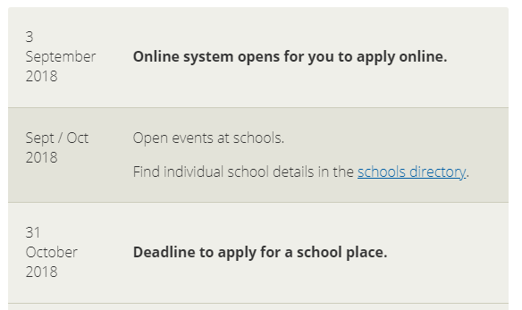
Secondary Transfer
1st March is National Allocation day

Slide 13
SATs
Week beginning 13th May
Not to be frightened of
Being prepared
Only expectation is of the children to do their best

Slide 14
School Journey
Week of 8th October
If any queries please ask (I have spare kit lists etc)
Other children in school

Slide 15
Thank You for coming!
Question Time...

