Slide 1
STRANGER DANGER

Slide 2
What is a STRANGER?
A “stranger” is someone you and your family do not know.
A stranger does not always look mean or scary!

Slide 3
There are two kinds of “Strangers”...
The first kind of stranger is
‘A Good Stranger’
What are some examples of good strangers?

Slide 4
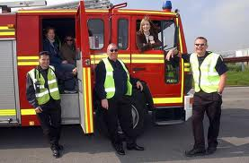
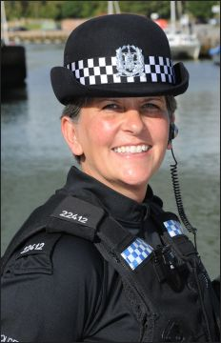
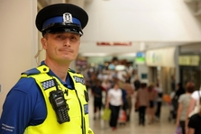
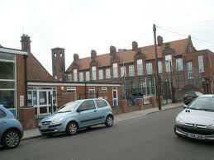
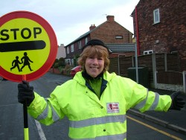
‘GOOD STRANGERS’...
Police Officer
Firefighters/Paramedics
Adults in a school
School crossing patrol

Slide 5
TALK TO YOUR PARENTS
ABOUT WHO A SAFE ADULT IS
Your parents love you and can give you important advice on who in your life are “safe adults”.

Slide 6
But HOW should we keep ourselves safe?

Slide 7
ALWAYS tell a safe adult if...
A stranger tries to get you to go someplace with them
A stranger offers you sweets or money or toy. DON’T TAKE ANYTHING FROM A STRANGER
A stranger asks you to go any place with him or her. IF YOU DON’T KNOW…DON’T GO
A stranger tries to join in when you are playing
A stranger asks you to do anything that makes you feel funny, or uncomfortable
It is OK to say NO to a stranger Be safe and don’t take any chances!!

Slide 8
What you SHOULD know...
1. Your name, address, and phone number
2. Your parent’s names and work phone numbers
3. What number you call in an emergency
The EMERGENCY number is...
999

Slide 9
RULES TO LIVE BY...
Only play in SAFE places
NEVER play in an unfamiliar place
Have a friend go with you when you play
DON’T stay out after dark
NEVER go ANYWHERE without your parents’ permission
ALWAYS check in with parents before changing locations, or if late.

Slide 10
STRANGER DANGER

