Slide 1
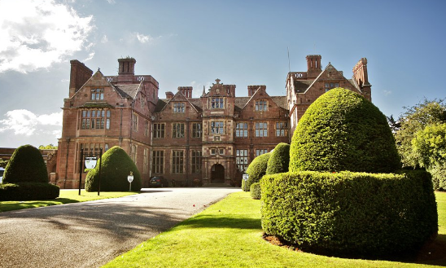

Tudor Primary School
Condover Hall, Shropshire
2020 Residential Trip
5th October 2020 – 9th October 2020

Slide 2
So why are we going?
To challenge ourselves
To build teamwork / leadership skills
To build our independence / raise self-esteem
Fun
Spend time with our friends
Make fantastic memories to keep forever...

Slide 3


Slide 4
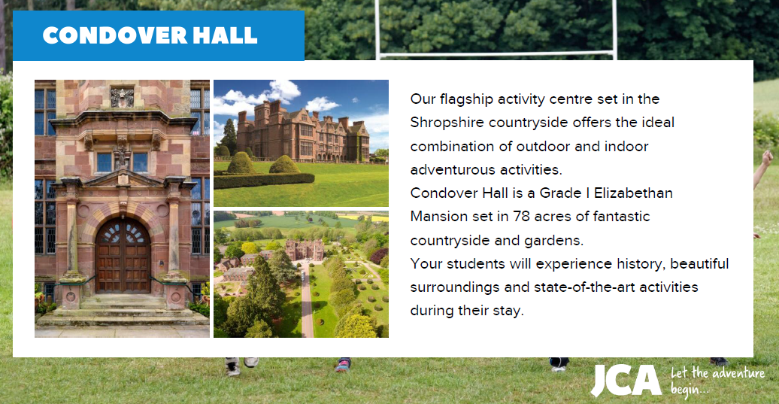

Slide 5
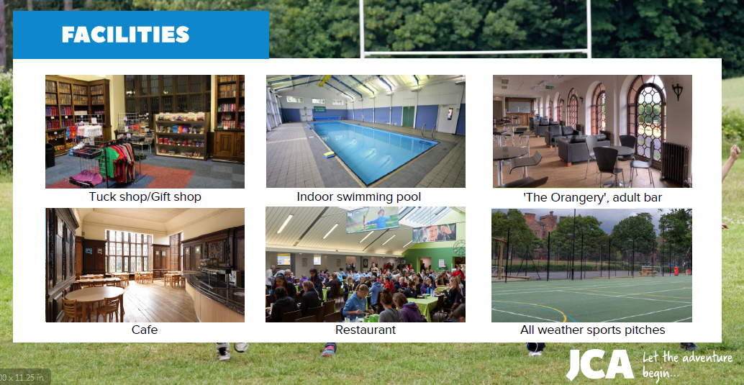

Slide 6
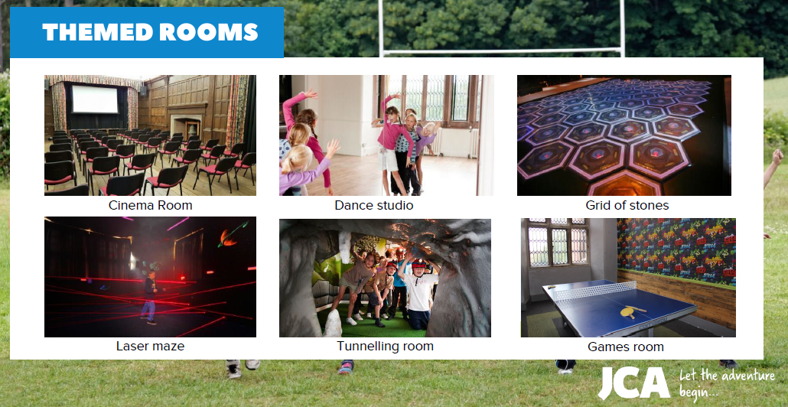

Slide 7
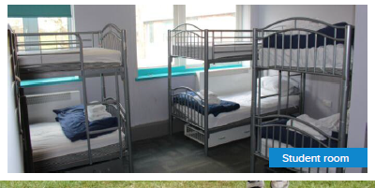
Accomodation

Slide 8
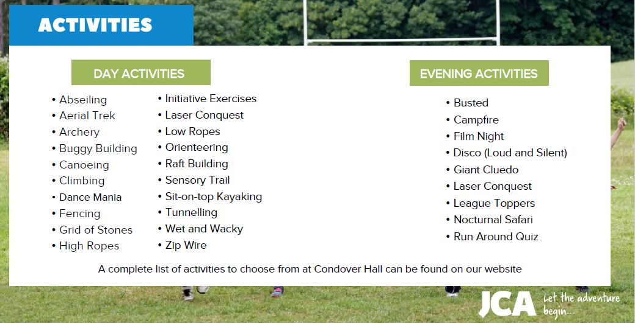

Slide 9
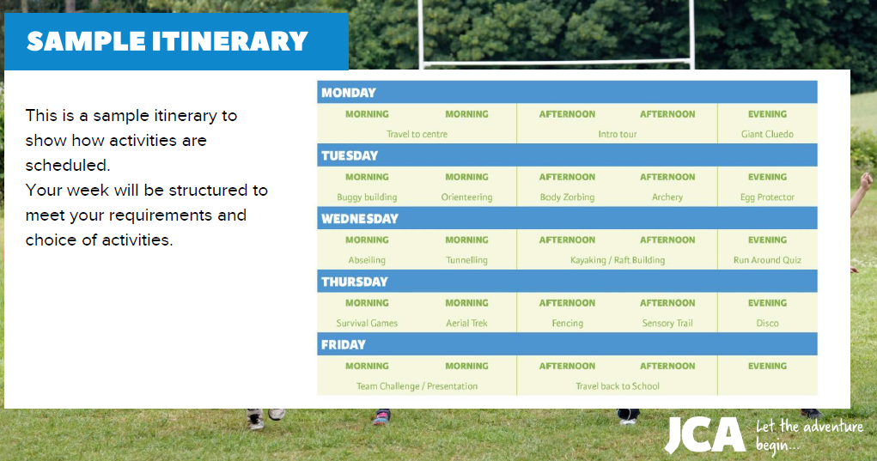

Slide 11
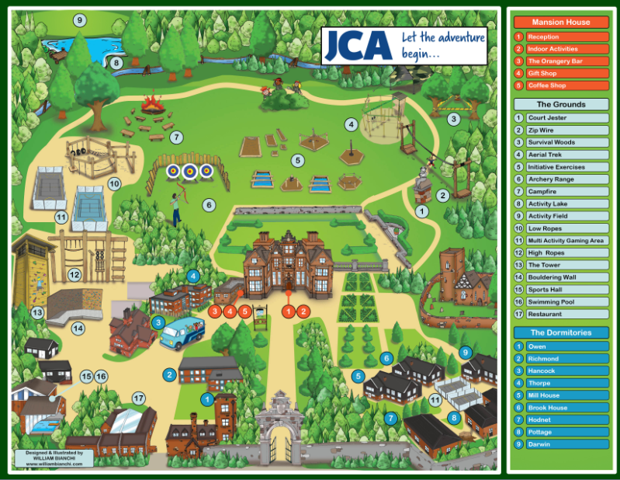

Slide 12
What do the Year 6’s think?

Slide 13
What to do next?
Get letter
Letter returned and deposit given by Friday 7th February

