Slide 1

Robert Peel
By Imogen Arje

Slide 2
Who was Robert Peel?
He was the British Prime Minister from 1834-1835, and 1841-1846
He studied classics and maths at Oxford University
He became an M.P when he was only 21
In 1844 he introduced the Factory Act, limiting the number of hours that women and children were permitted to work in factories
During his time as Prime Minister, he reintroduced income tax in order to reduce taxes on goods.

Slide 3
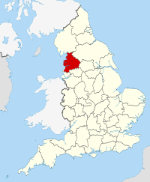
He was born in bury, Lancashire in 1788.
This Photo by Unknown Author is licensed under CC BY-SA

Slide 4
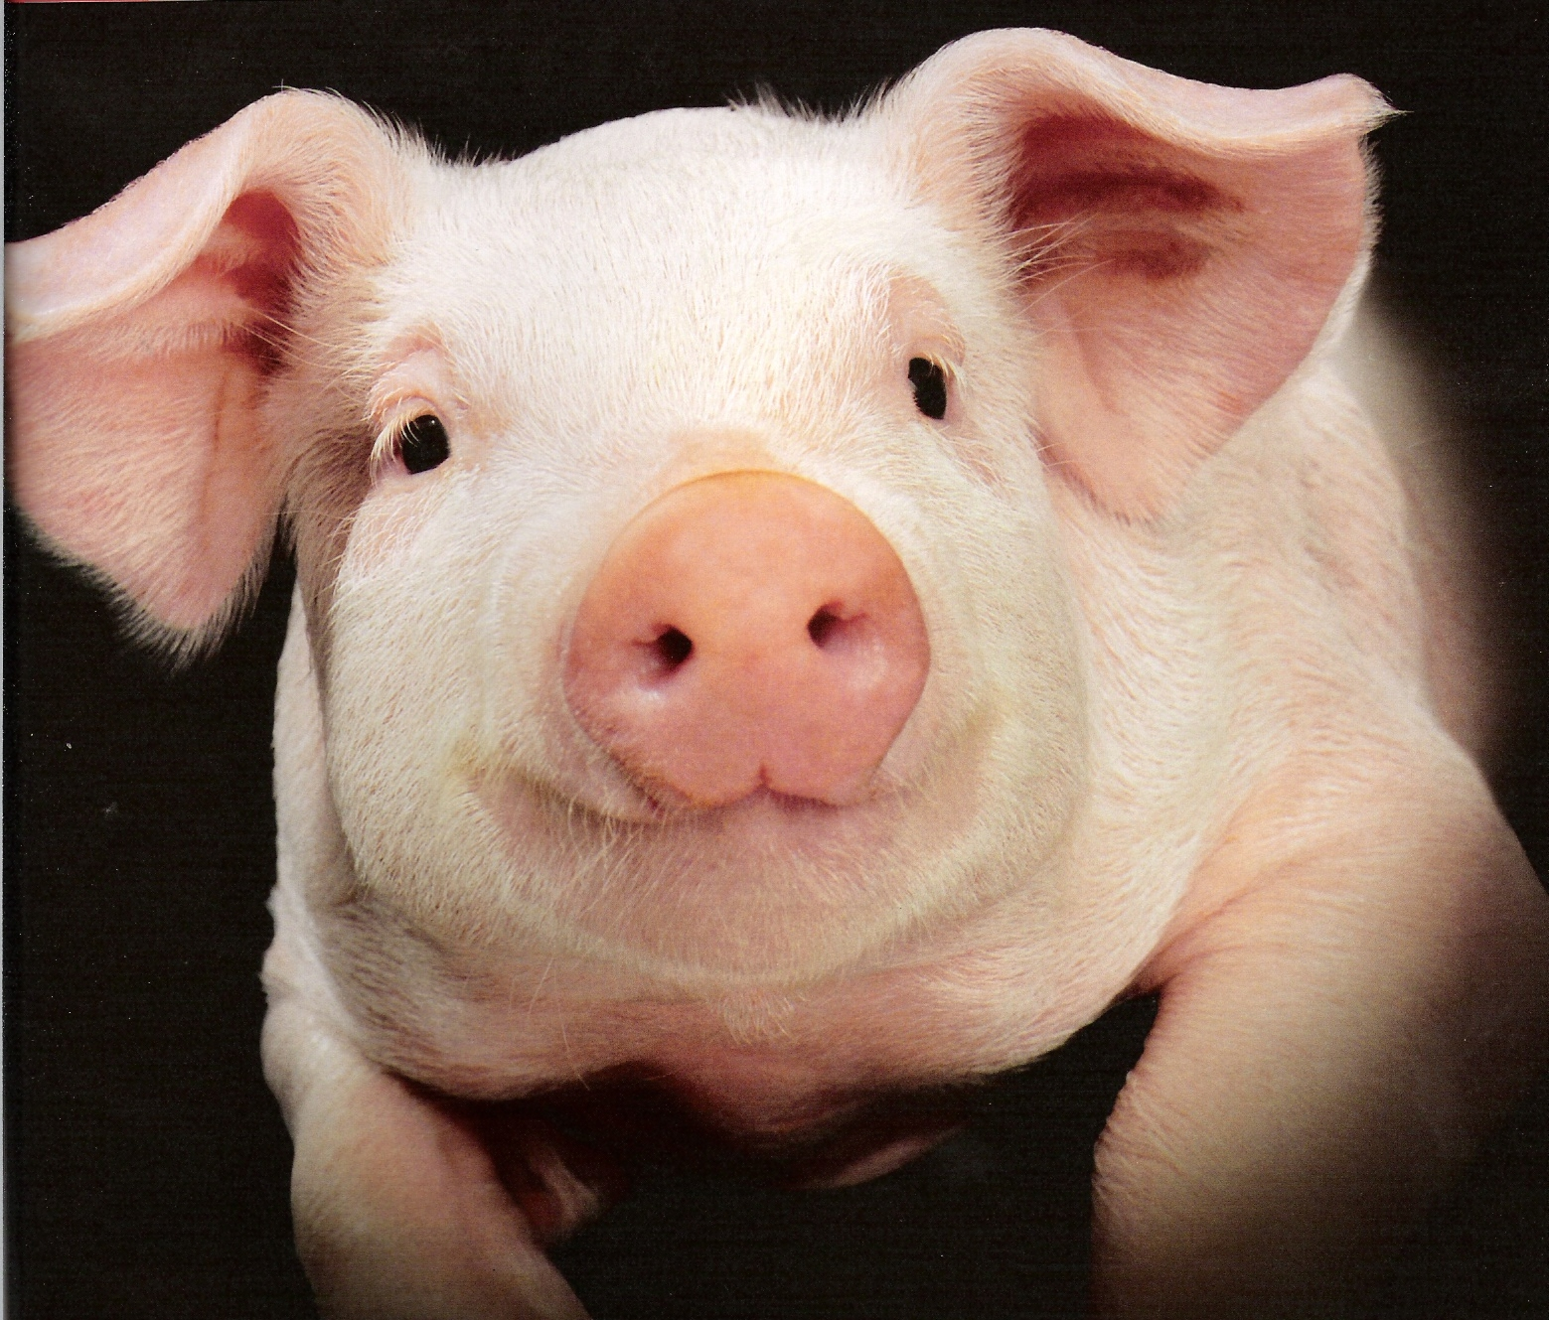


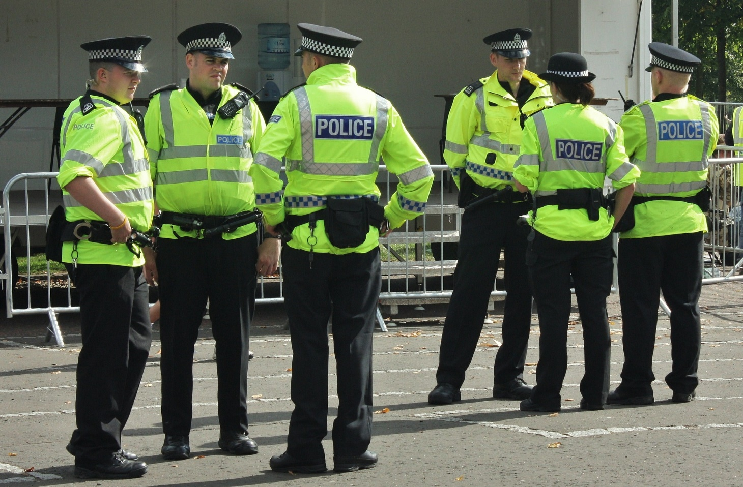
He started the first police force in Britain in 1829
This is why they are known as ‘Bobbies’
This Photo by Unknown Author is licensed under CC BY-SA

Slide 5
Robert Peel bred the first Tamworth pig, by crossing pigs local to Tamworth with pigs from Ireland

Slide 6


He had 5 sons and 2 daughters
That means our dad has 7 children.
I want another sister!

Slide 7
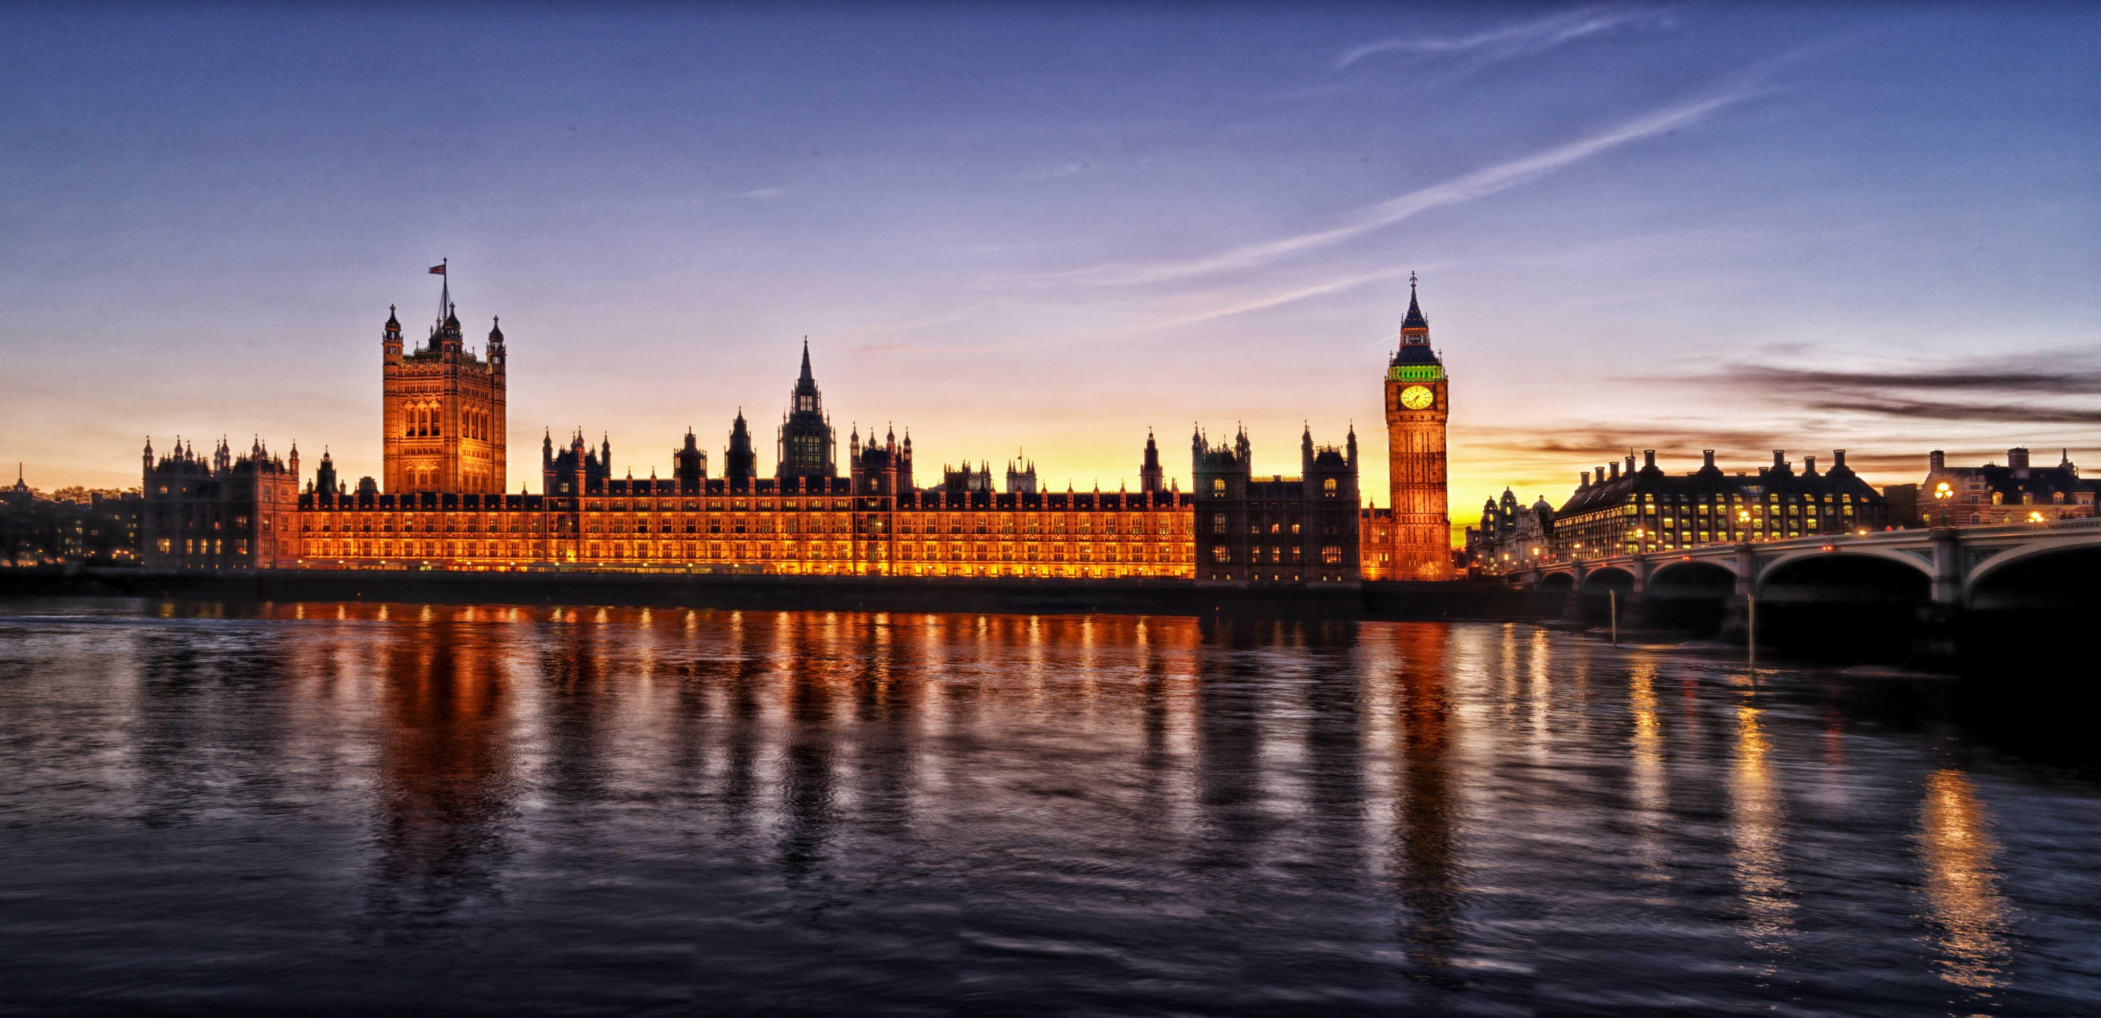
Robert Peel held a number of government posts (in both England and Ireland) before becoming Home Secretary in 1822.
This Photo by Unknown Author is licensed under CC BY-SA

Slide 8
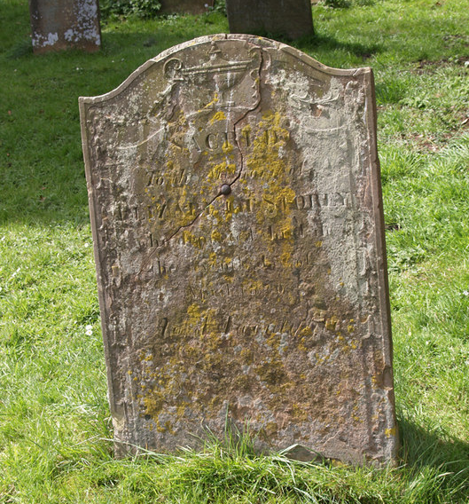
He died in 1850
This Photo by Unknown Author is licensed under CC BY-SA

