Slide 1
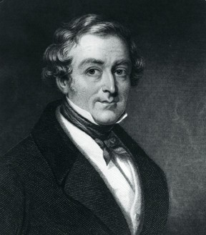
Sir Robert Peel
1788-1850

Slide 2

Facts
He became a member of parliament at only 21.
In 1829 he set up the Metropolitan Police Force based at Scotland Yard.
He served as a Member of Parliament for Tamworth between 1830 and 1850.
He is credited with breeding the first Tamworth pig with pigs from Ireland.
He died in 1850 following a riding accident.

Slide 3
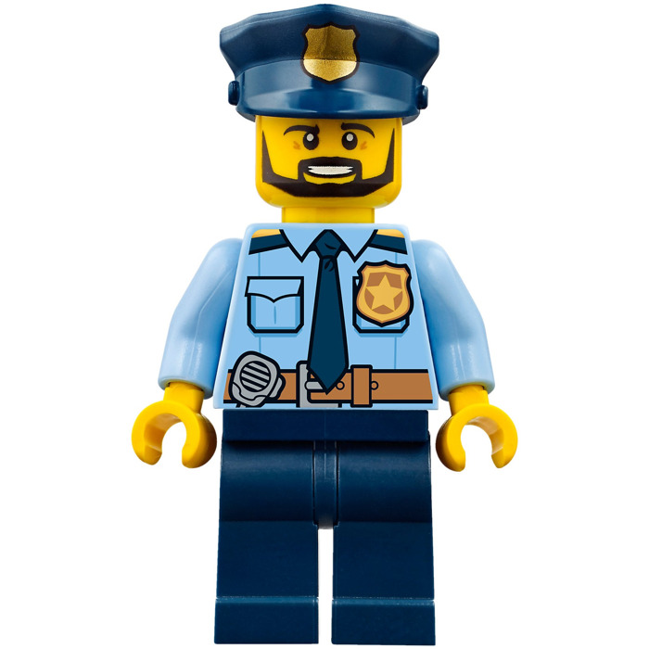
Additional Facts
He employed 1000 police constables and they became known as Bobbies.
You had to grow a beard to become a police officer at that time.
In 1844 he introduced the factories act, limiting the number of hours that women and children were permitted to work in factories.

