Slide 1
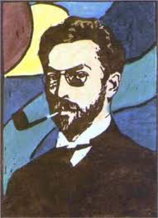
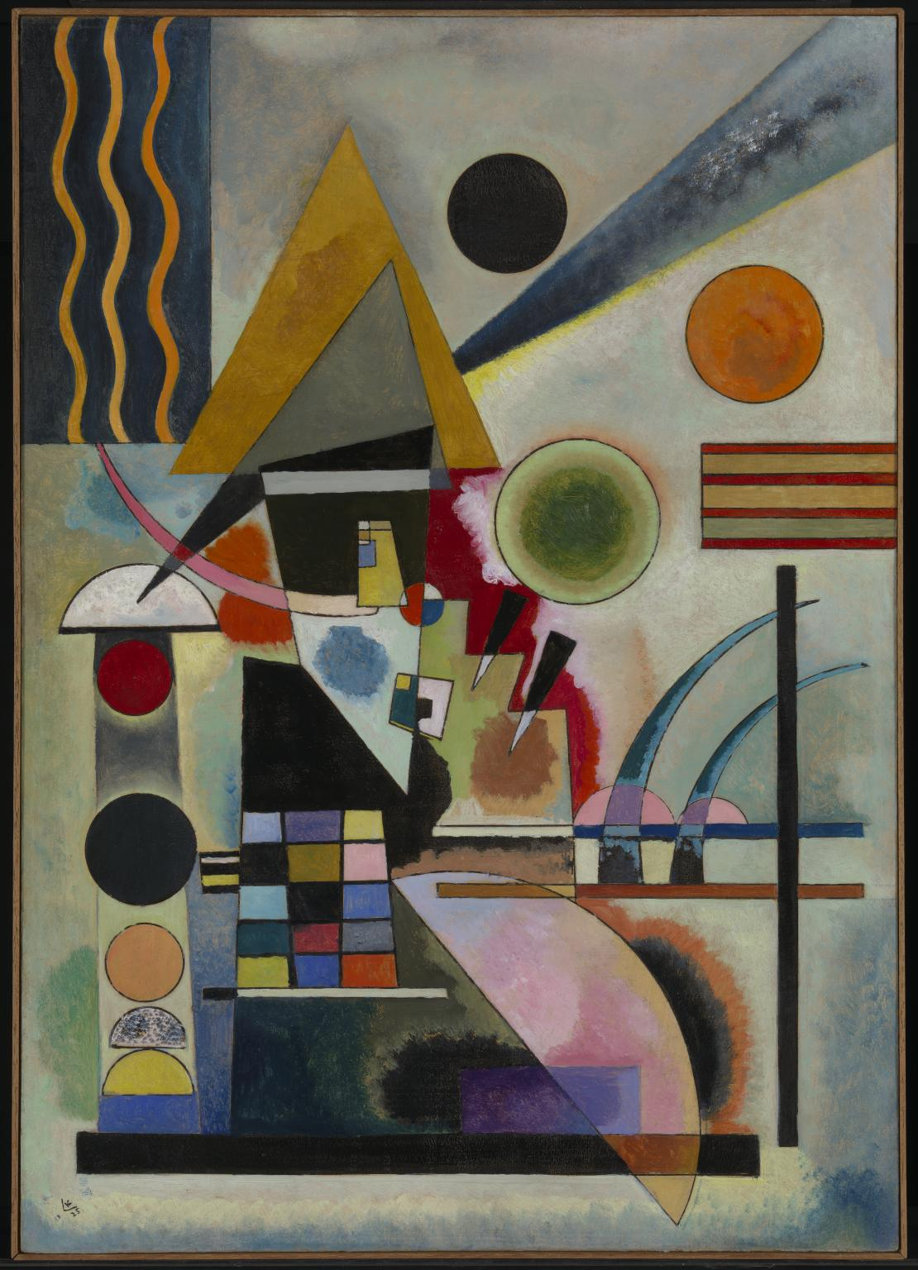
Wallisy Kandinsky
1866 - 1944
Swinging 1925

Slide 2

Facts
Russian painter and art theorist
Kandinsky is generally credited as the pioneer of abstract art.
Born in Moscow
Kandinsky spent his childhood in Odessa, where he graduated at Grekov Odessa Art school.
He enrolled at the University of Moscow, studying law and economics.

Slide 3
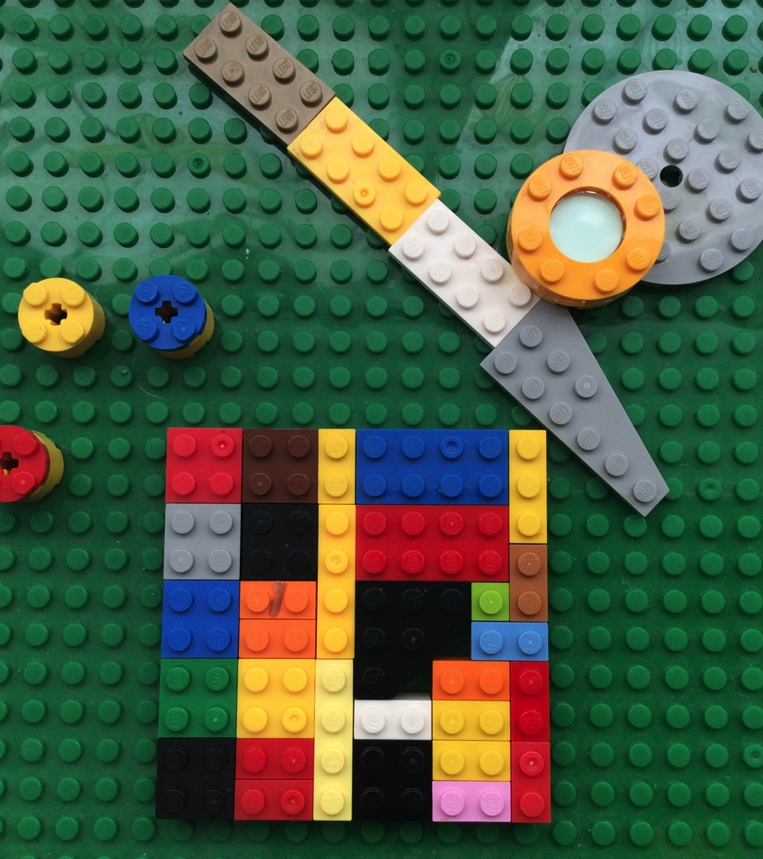
My Lego Kandinsky picture by Callum B

