Slide 2
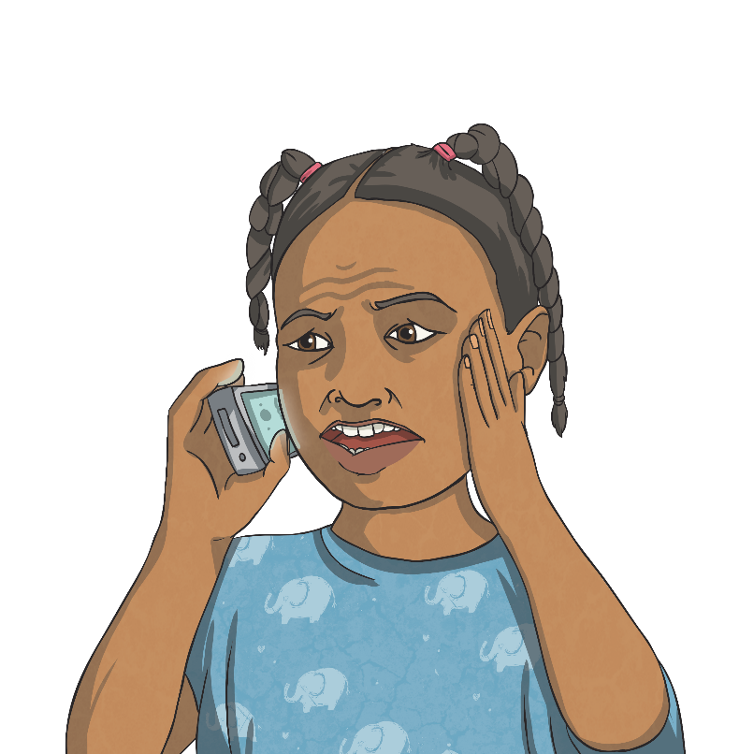
The Emergency Services
The police service is one of the emergency services. The main emergency services are:
Police
Fire Brigade
Emergency Medical Service
All these services can be reached by dialling 999. When you phone this number, the operator will ask you which emergency service you need. If you aren’t sure, you can explain the situation and they will put you through to the right service.
Other emergency services in the United Kingdom include
the Coastguard and Mountain Rescue.
Although 911 is the number for emergency services in the USA, the phone system in the UK would send 911 calls through to 999.
Dialling 999 isn’t the only way to reach the emergency services.
You can also dial 112.
Did You Know?
Did You Know?

Slide 3
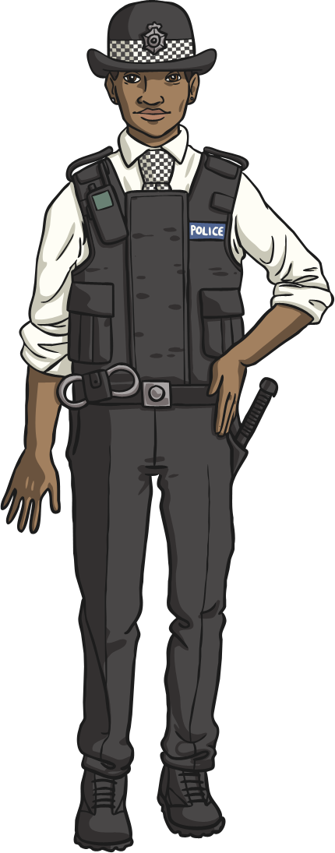
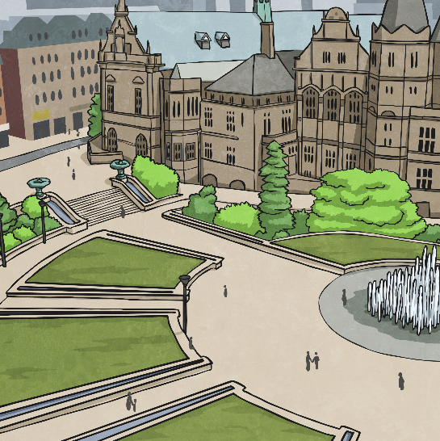
The Role of the Police
Although the police do a variety of things, their main duties are:
to maintain law and order (this means making sure people
keep the country’s laws);
to protect members of the public;
to protect people’s property;
to prevent, detect and investigate crime.
Across the United Kingdom, the police service is divided into different geographical areas called constabularies. There are 45 constabularies.
The largest constabulary is the Metropolitan Police Service (known as the Met), which serves Greater London.
There used to be a minimum height requirement for people who wanted to join the police force. Men had to be at least 5 foot 8 inches (1.73 metres) and women had to be at least 5 foot 4 inches (1.63 metres). Now there is no minimum height requirement.
Talk About It
Have you ever met a police officer?
Did You Know?

Slide 4
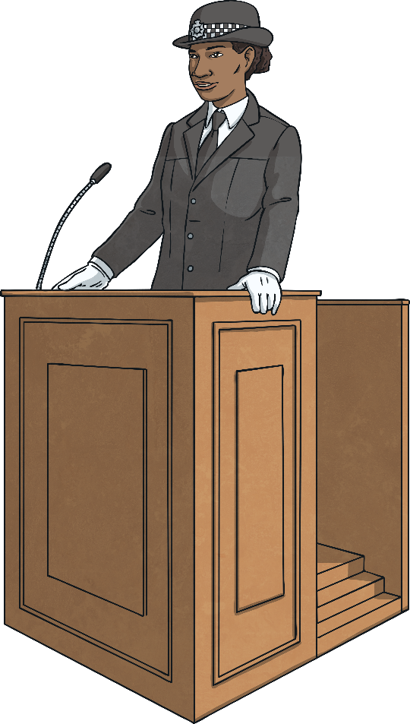
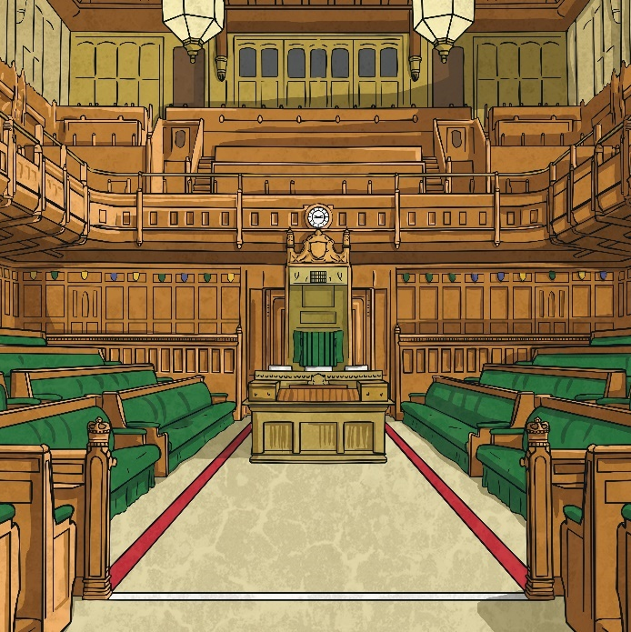
The Police Officer’s Oath
In England, when a person becomes a police officer, they make the following oath:
I do solemnly and sincerely declare and affirm that I will well and truly serve the Queen in the office of constable, with fairness, integrity, diligence and impartiality, upholding fundamental human rights and according equal respect to all people; and that
I will, to the best of my power, cause the peace to
be kept and preserved and prevent all offences
against people and property; and that while I continue to hold the said office I will, to the best of my skill and knowledge, discharge all the duties thereof faithfully according to law.

Slide 5
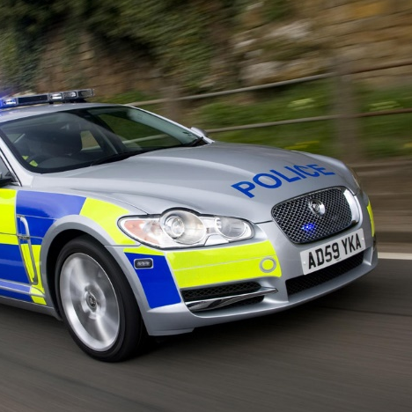
Different Types of Police Officers
Police have ranks. This means different titles and levels of responsibilities. An officer joins as a Police Constable (PC). Other ranks include Sergeant, Inspector and Chief Inspector. The highest ranking police officer is known as a Chief Constable or Commissioner.
Within the service, there are different types of police. Some of them include:
CID (Criminal Investigation Department) – These police officers investigate crimes. They don’t usually wear uniform.
Traffic police – These officers are specially trained drivers.
They patrol roads, such as motorways, and can be
involved in chasing criminals in cars.
There are also people called Special Constables.
These are volunteers who work alongside local police officers.
Unlike many areas of the world, most British police officers do not carry guns.
Did You Know?

Slide 6
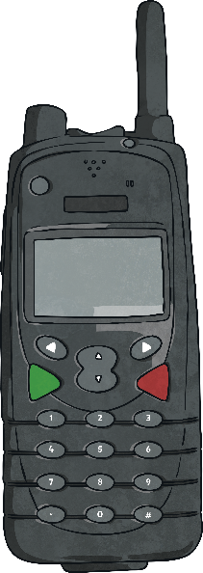
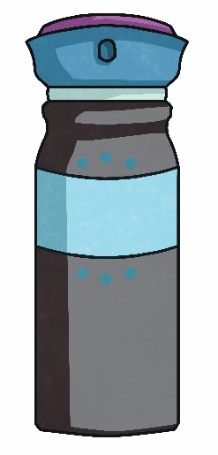
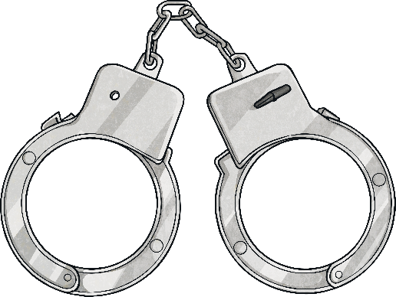
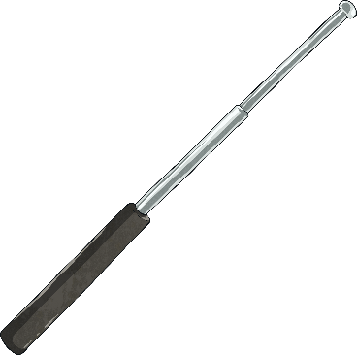

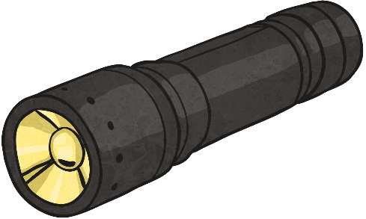
Police Equipment
Most police officers wear a uniform and carry special equipment. Although the design of uniform varies in each constabulary, most police officers carry the same type of equipment.
Handcuffs – these can be snapped onto criminals’
wrists quickly.
Baton – these usually fold in on themselves like
a telescope.
Radio – used to contact other officers and the
police station.
CS Spray – if a criminal is resisting arrest, this
can be sprayed to subdue them.
Torch – police work all through the night and
often investigate crimes in dark areas.
Police notebook – the police have to record
everything they do. These notebooks can then be
examined in court cases.
Did You Know?
Each police officer has their own identity number.
Often these can be seen on an officer’s shoulder.

Slide 7
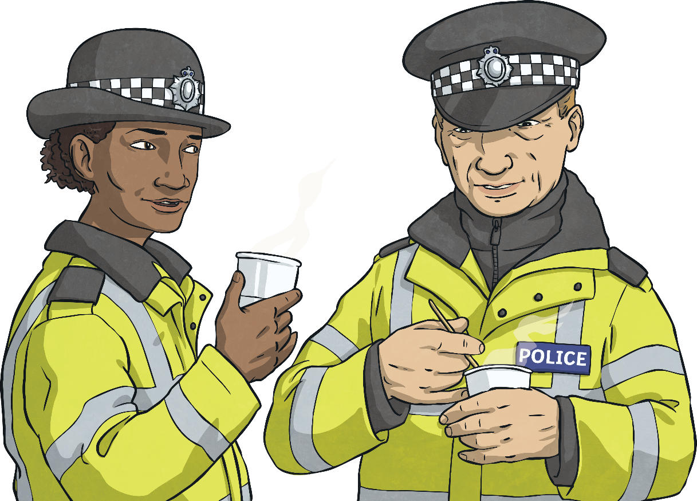
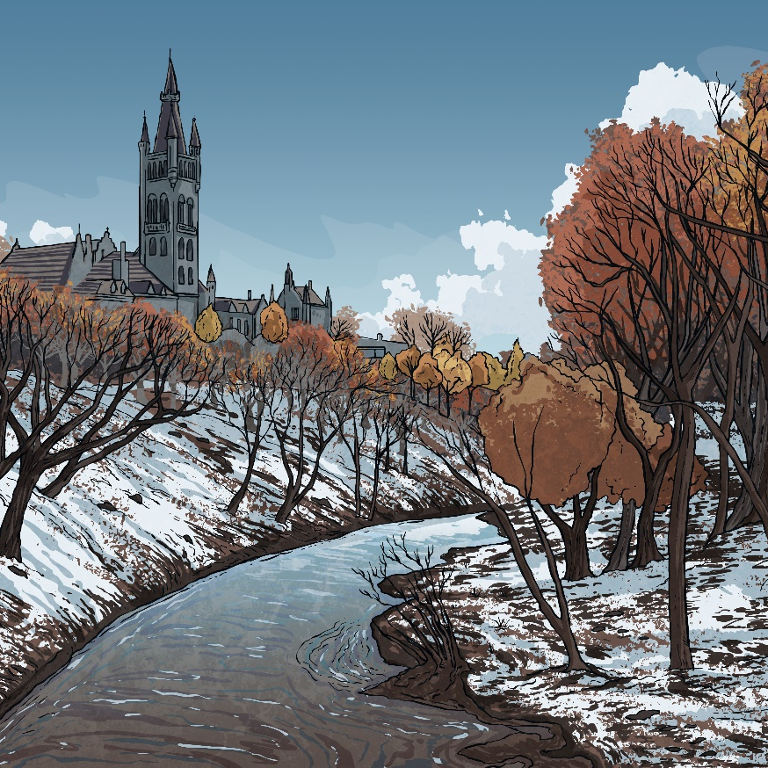
The History of Police
In the past, maintaining law and order was done using volunteers. There were early versions of the police, such as the ‘Bow Street Runners’ formed in 1749, who were a group of constables paid to patrol London at night.
In 1829, Sir Robert Peel, who was Home Secretary, passed a law called the Metropolitan Police Act. This was a
full-time, professional police service that covered London. Gradually, other areas of the country also established their own police services.
Did You Know?
Police are sometimes known as ‘bobbies’. This is because the first police officers were nicknamed this after Sir Robert Peel.

