Slide 1
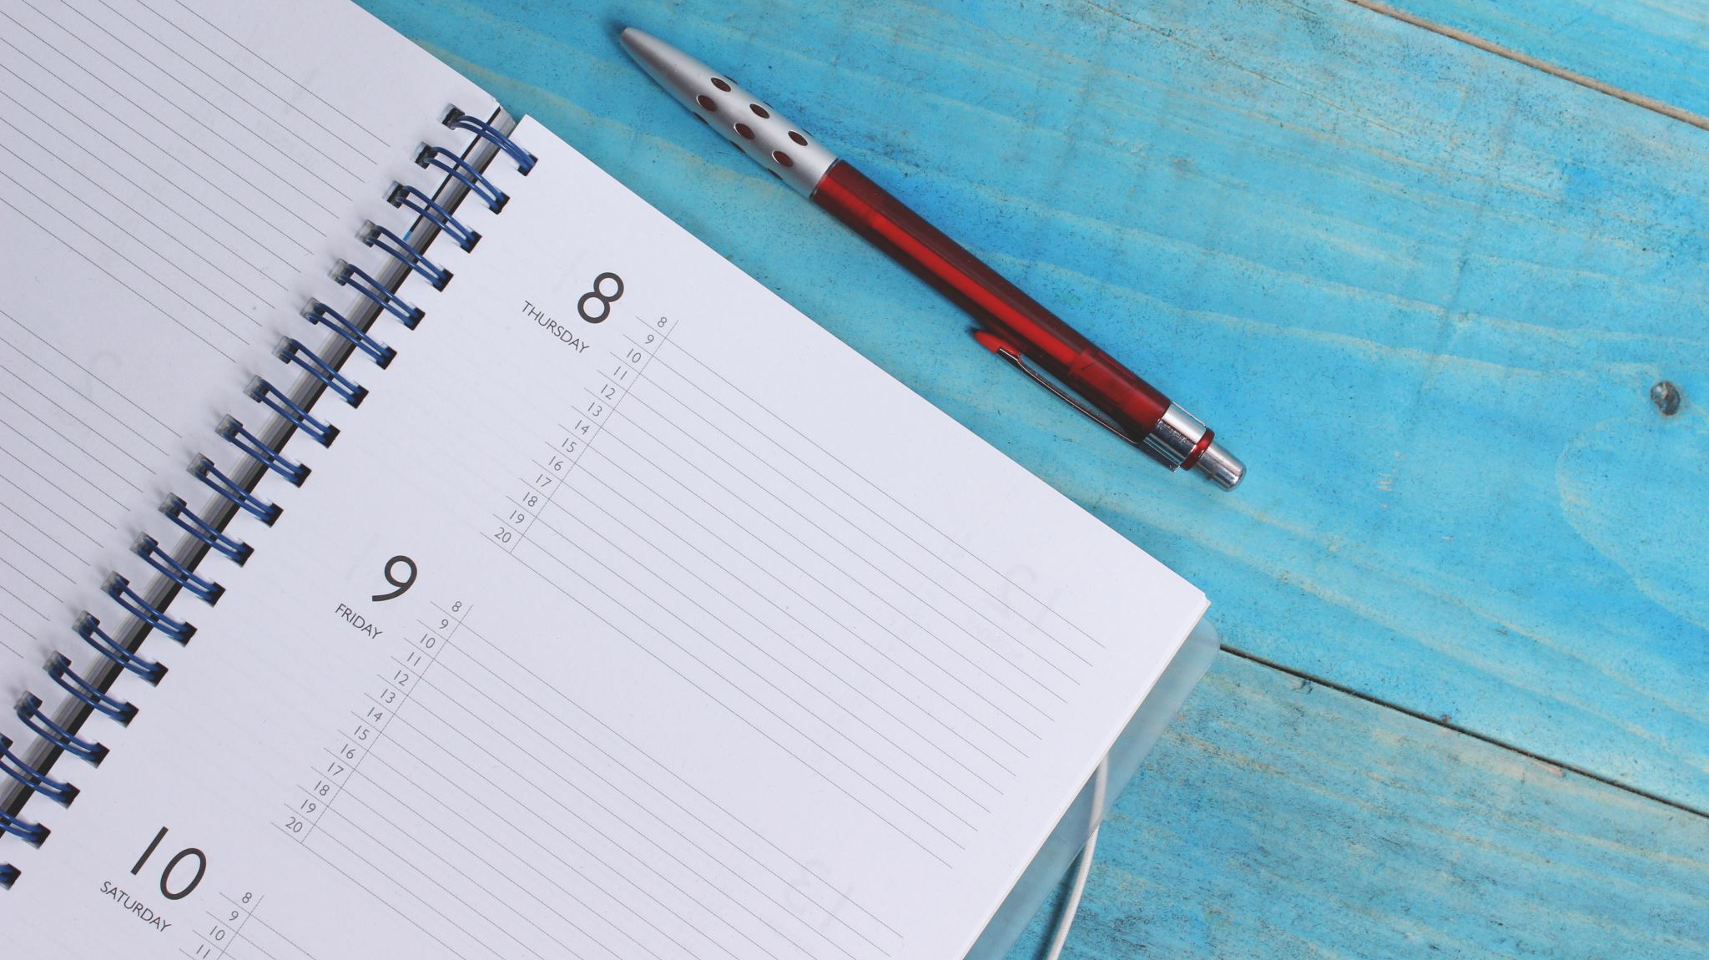
POLICE
BY Imogen aRJE

Slide 2
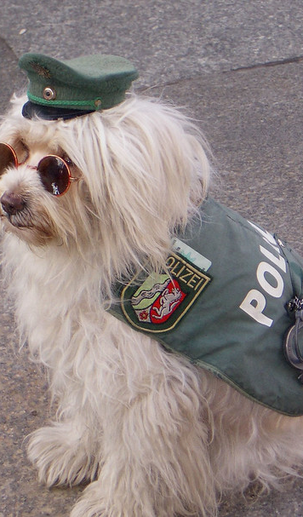
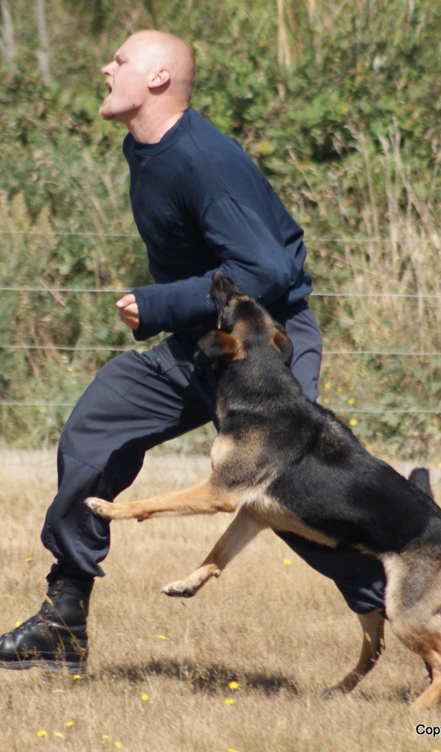
A K-9
A police dog is also known as a k-9,who helps police officer to solve crimes a bit more quickly, because they can sniff for the criminals.
This Photo by Unknown Author is licensed under CC BY
This Photo by Unknown Author is licensed under CC BY-SA

Slide 3
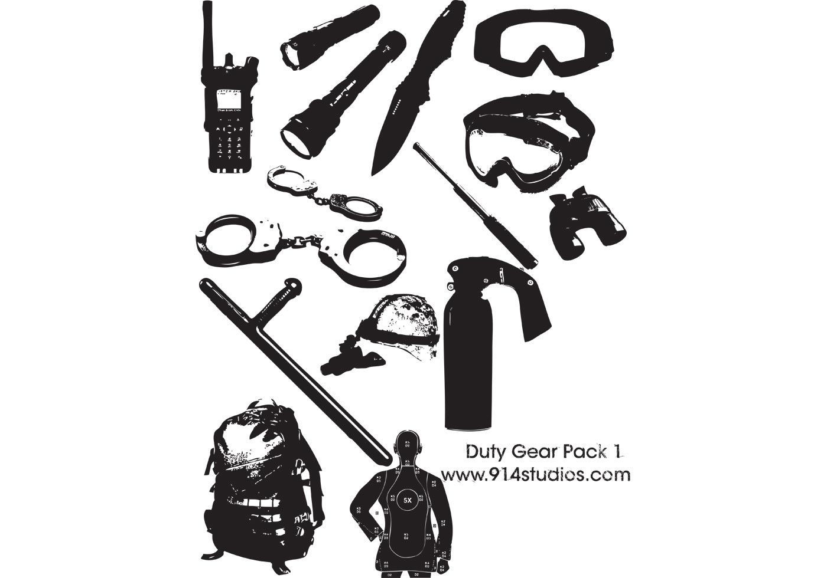
WHAT THINGS POLICE CARRY AROUND WITH THEM
A WALKIE TALKIE /TWO WAY RADIO
HAND CUFFS
A FLASH LIGHT
A protective vest to make sure that the don’t die by the guns
This Photo by Unknown Author is licensed under CC BY-SA

Slide 4
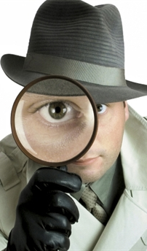
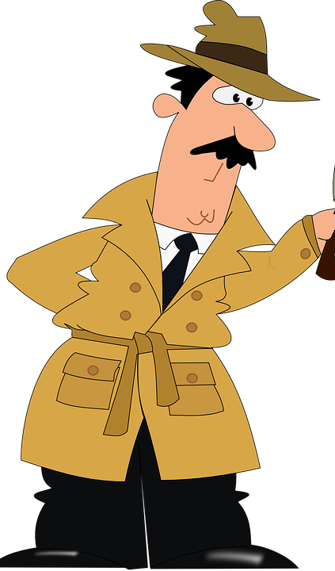
Ranks
Police have ranks. This means different titles and levels of responsibilities. An officer joins as a Police Constable (PC). Other ranks include Sergeant, Inspector and Chief Inspector. The highest ranking police officer is known as a Chief Constable or Commissioner
This Photo by Unknown Author is licensed under CC BY-NC-ND

Slide 5
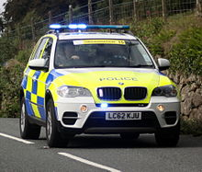
THE END

