Slide 1
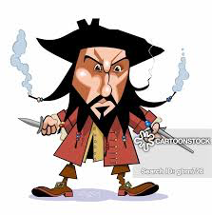
Join the Crew!
Do you want so much money that you can’t count it?
Go on amazing adventures without getting hurt? *
How to contact
Call Captain Callum on 09176122 and sign up (do not tell anyone otherwise your life could be totally at risk.
Join now for free!
You will definitely not regret this amazing experience. Stay tuned for more offers
T&C * you might not get hurt but you might get killed

