Slide 1

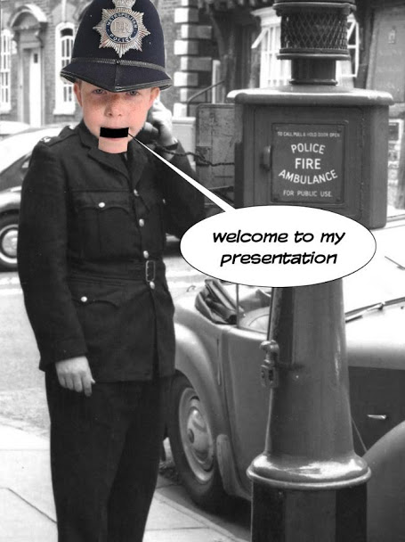
by
Ellis Ladmore
This Photo by Unknown Author is licensed under CC BY-SA

Slide 2
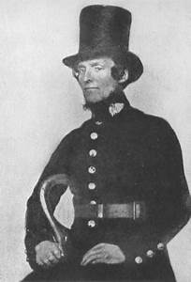
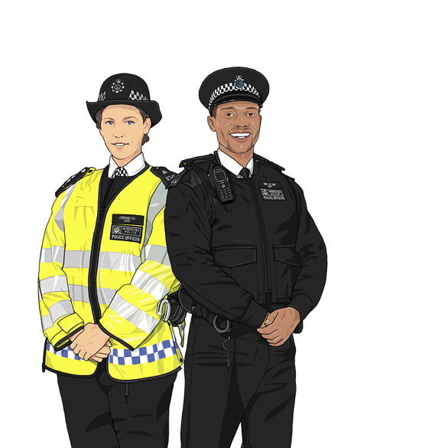
You are under a vest…..
Big Hat for carrying lunch
Reflective Jacket
Black
Suitable
Old - 1829
Which is the better uniform?
New - 2020

Slide 3
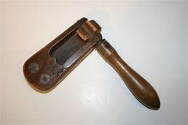

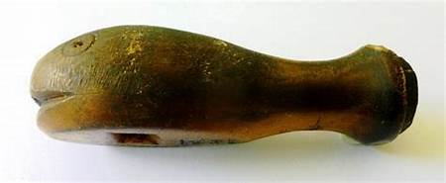
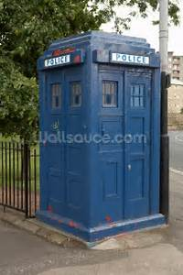
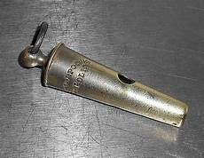
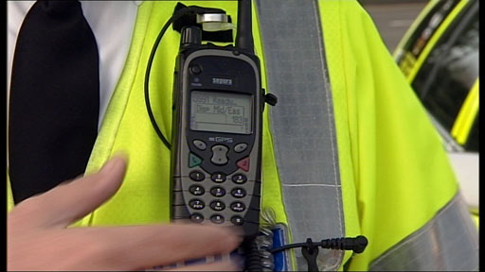
Hello, hello, hello…….. What’s all this noise then?
Rattle
Whale Bone Whistle
Whistle
Radio
Police Phone Box

Slide 4
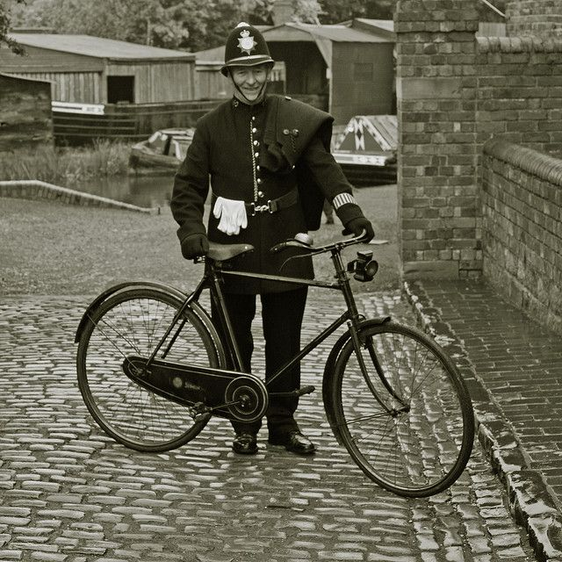
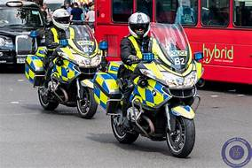
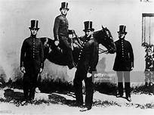
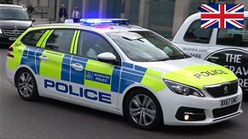
Changes in Transport.
Bicycle
Doesn’t run out of fuel.
Can go on paths
Motor Bike
Fast
It looks cool
Get through traffic
Horse
Slow
Hungry
Its smelly and Poos in the road
Police Car
Fast
Sirens to get through traffic
Carry more people

Slide 5
In conclusion……
My favourite page is the joke about being under a vest.
I like the new Police uniform the best because it looks lighter than the old and cars can see you.
I like the Police radio the best because you can talk to people quicker and people may not hear the whistle.
I like the Police motorbike the best because of the cool siren!

Slide 6
Thank you and that’s all folks!

