Slide 1
Pirate Fact File
By Edward

Slide 2
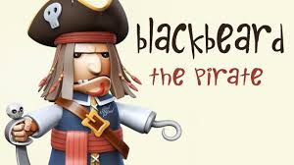
Blackbeard was the most feared pirate of all.
He also set his beard on fire.
The scull and crossbones are called the Jolly Roger.
Not every pirate ship used a J olly Roger.

Slide 3
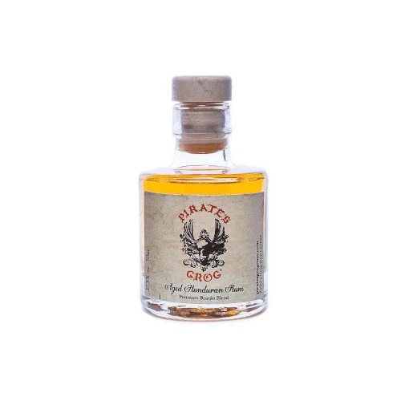
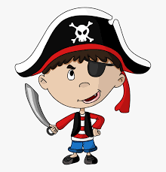
Grog was the pirates drink which is made from rum, water, lemon juice, sugar.
The reason pirates wore eye patches was to help keep one eye adjusted to night vision for seeing below deck.

Slide 4
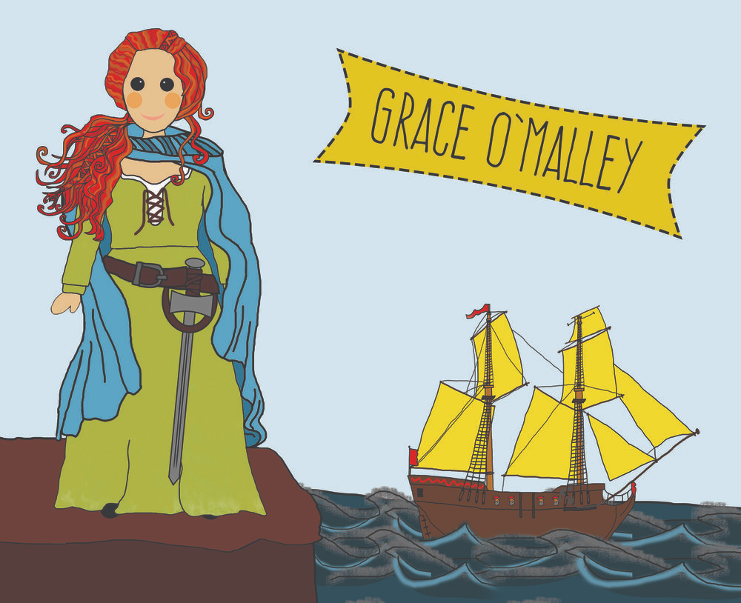
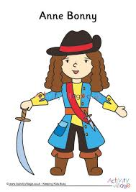
There were women pirates such as Grace O'Malley and Anne Bonny
Pirates didn't really make people walk the plank, they would just kill you straightaway

Slide 5
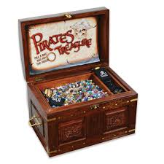
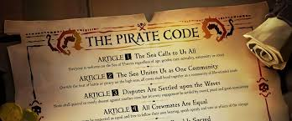
Pirates treasure didn't always include gold or silver, most of it was food, lumber, cloth and animal hides.
Each pirate ship had its own set of rules and code
The most common rule was no fighting on board

Slide 6
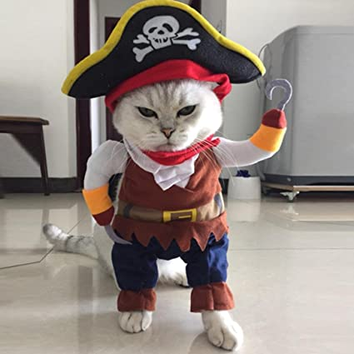
THANK YOU FOR LISTENING
I hope you enjoyed my presentation about pirates.

