Slide 1
Robin Hood
By Jude Regragui

Slide 2
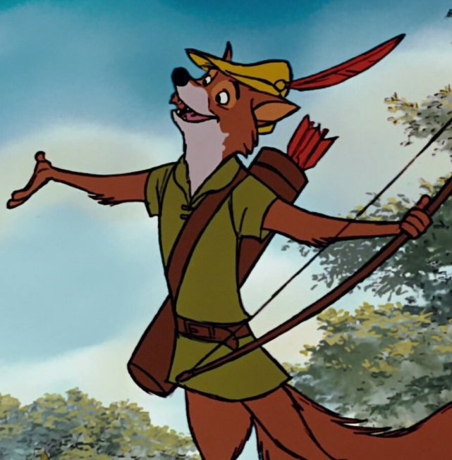
Hello and welcome to my presentation . My name is Jude and I will talk about Robin Hood.

Slide 3
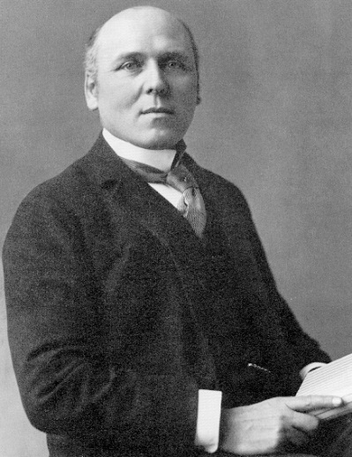
The story of Robin Hood was written by Howard Pyle and was sometime written at around 1377

Slide 4
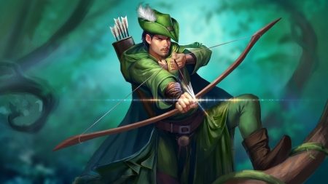

Robin hood is an important character as he is a symbol of the spirit and stood up to the rich and stole from them to help the poor . Making him a kind and respectful character

Slide 5


After reading the story of Robin Hood l learned to never give up and to keep trying until you get what you want like Robin Hood

