Slide 1
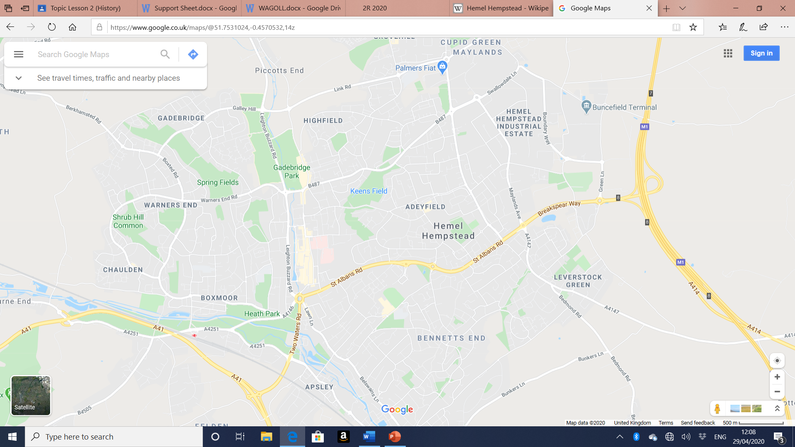
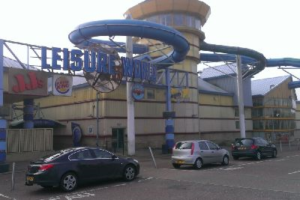
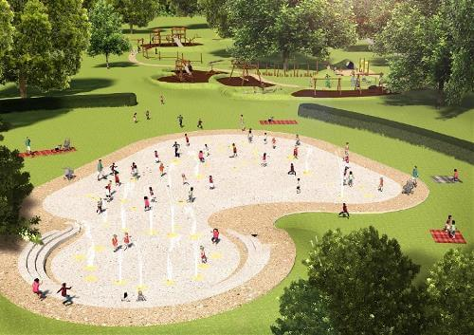
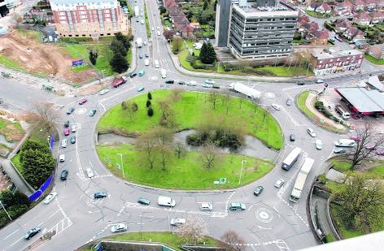
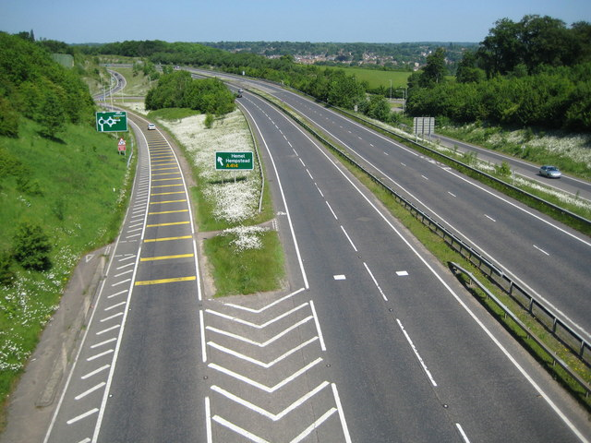
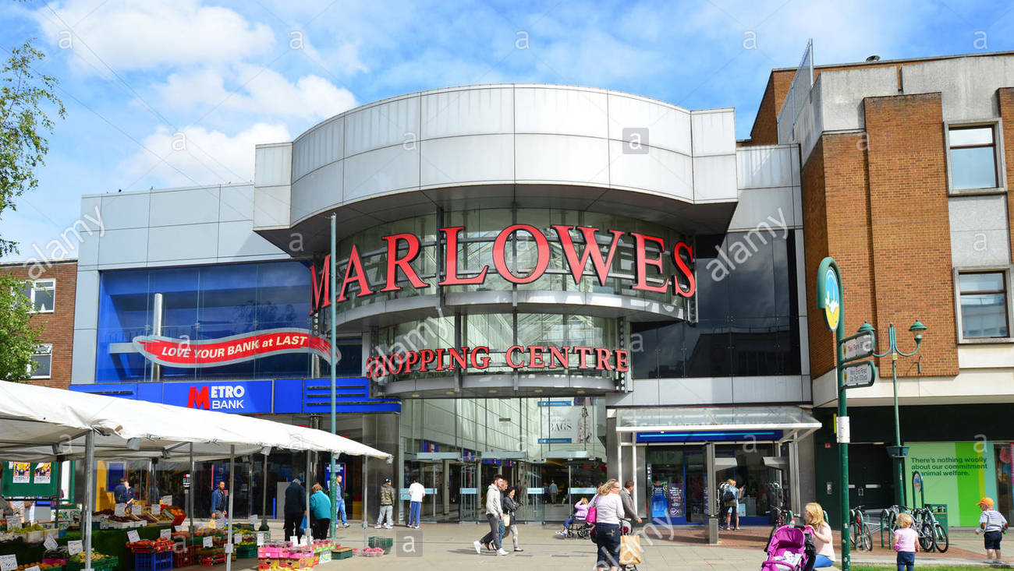
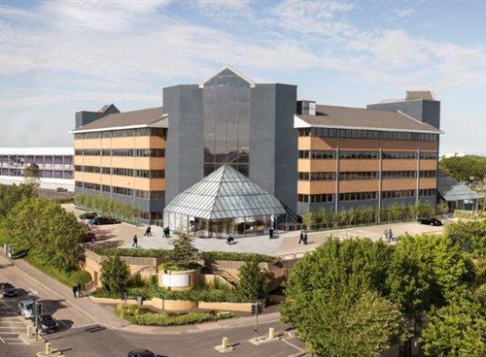
Feature added
Photo
Why it was built
Jarman park
Population increased and people had more money
Gadebridge park playground
Council had more money for fun/people realised children's needs
Magic roundabout
To organise traffic and roads
A41
More cars on the road and to make travelling easier
Marlowes shopping centre
Under one roof and people had more money
Maylands industrial area
Boom in British industry and population increased so more people need jobs

