Slide 1
Welcome to
Year 6

Slide 2
YEAR 6 TEAM
Mr Munro (6Y)
Mrs Butler TA
Mrs Smith
Miss Cohen (6Z)
Mrs Edwards TA
Mrs Butler
Mrs Smith

Slide 3
Year Six - ‘Meet the Teachers’
What topics will they be studying?
A Whole New World (Autumn)
Spaceship Earth (Spring)
It’s all Greek to Me (Summer)

Slide 4
Year Six - ‘Meet the Teachers’
What is expected of my child?
To be independent in school routines and in their learning
To be motivated to develop their reading, writing and maths skills as well as others throughout all curriculum areas
To be role-models and set an example around school
To prepare themselves for secondary school

Slide 5
Year Six - ‘Meet the Teachers’
What can parents do to help?
Home/School Diaries
Punctuality and Attendance
Home learning tasks
Helping them to develop independence with
organisation
Checking the website
Signing the reading record

Slide 6
Home/School Diary (red book)
To be brought into school every day
A place to communicate essential information with your child's teacher
Please check each night and indicate if you have read any messages
Children need to inform an adult in school if there is a message from home in there for them
For sensitive issues and more detailed information, you can still call or arrange to speak to teachers face to face

Slide 7
Morning Work
Every morning when children arrive, they will have a learning task to complete from 8:45.
This is a key task which helps to consolidate, support or extend children’s learning.
They are expected to partake fully in this task.

Slide 8
Attendance
School target is 97% (we are currently at 95%)
6 days off throughout the whole year will be under target
Your child’s wellbeing, self esteem and confidence is improved
Easier to build and maintain good friendships
Lessons are planned to be sequential and are built on day by day – so learning is made easier
The school is now using fixed term penalties for numerous unapproved absences, so always ring in and say why your child is off

Slide 9
Home learning
Weekly Spelling home learning task given out on Mondays and due in on the following Monday
Weekly home learning tasks for Grammar, Reading and Maths are given out on Tuesdays and due in on the following Tuesday
Daily reading (support by signing record)
Weekly SPaG.com and Spelling Shed activities
Additional activities as needed

Slide 10
Organisation
PE – Monday and Tuesday (Full kit needed all week)
Looking after their belongings
Travelling to and from school (to arrive from 8.45)

Slide 11
Website
Blogs, letters, dates
http://www.tudor.herts.sch.uk/

Slide 12
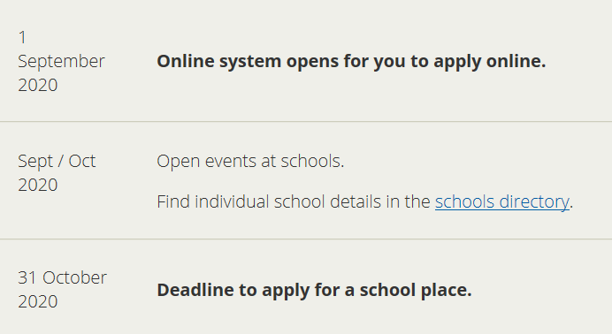
Secondary Transfer
1st March 2021 is National Allocation day

Slide 13
SATs
Week beginning 9th May 2021
They are not something to spend the whole year worrying about
We do practise assessments throughout the year to ensure the children are prepared
We all just want the children to do their best

Slide 14
School Journey
Week of 7th October
If any queries please ask (I have spare kit lists etc)
Other children in school
When we have news regarding COVID alterations we will contact you

Slide 15
If you have any questions, please write a note in the red book.

