Slide 1
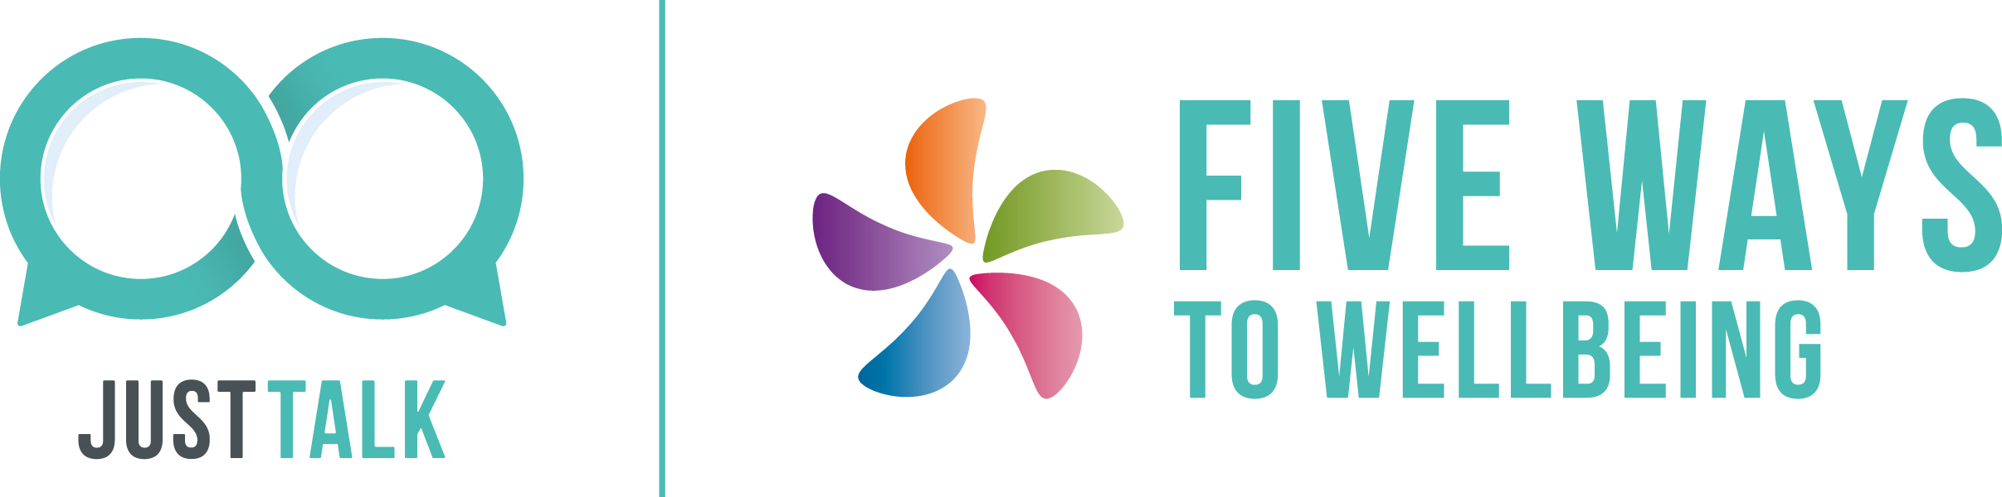

Slide 2
Why the Five Ways?
Like physical health, we can all benefit from looking after our mental health.
Research has identified five simple things we can do – the Five Ways.
When practised regularly, they build resilience, boost wellbeing and offer some protection from developing mental health problems.
They’re beneficial for everyone, whether you have a mental health problem or not.

Slide 3
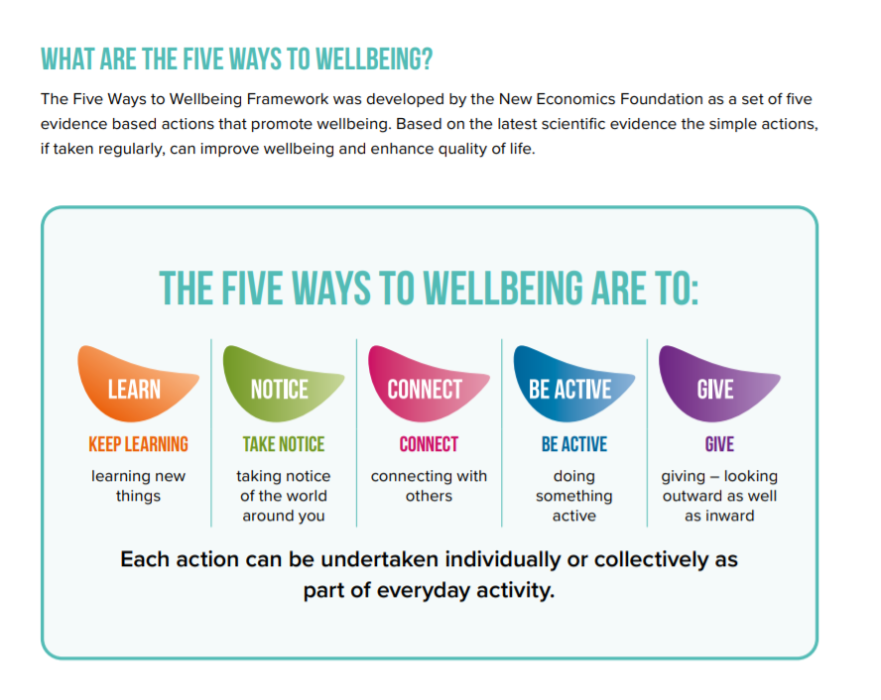

Slide 4
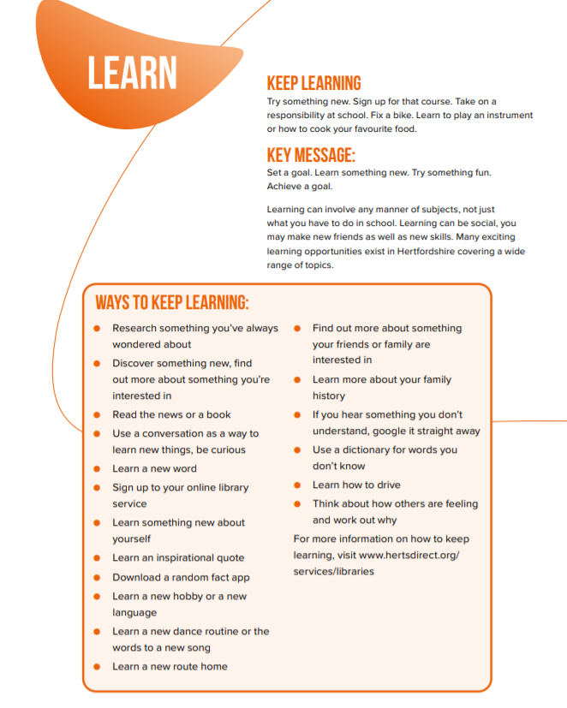

Slide 5
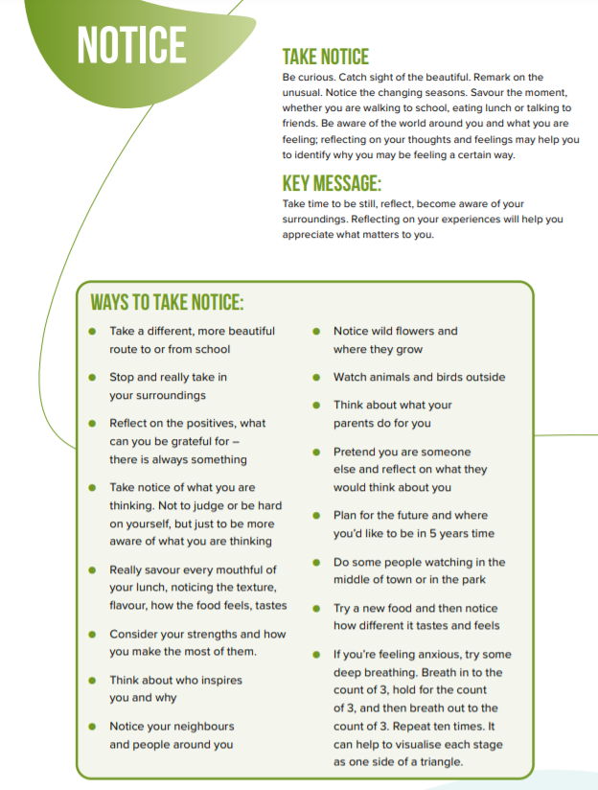

Slide 6
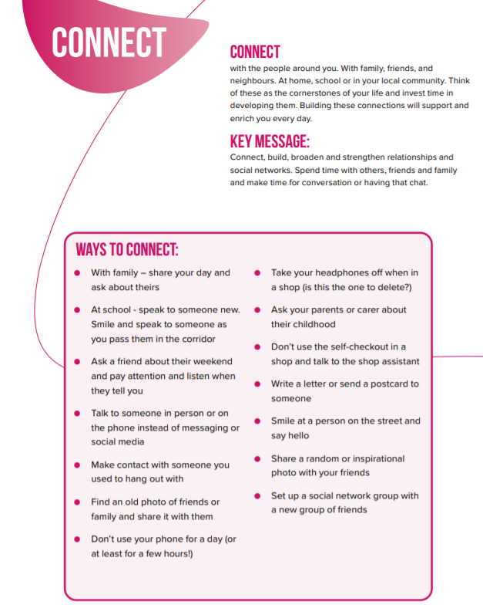

Slide 7
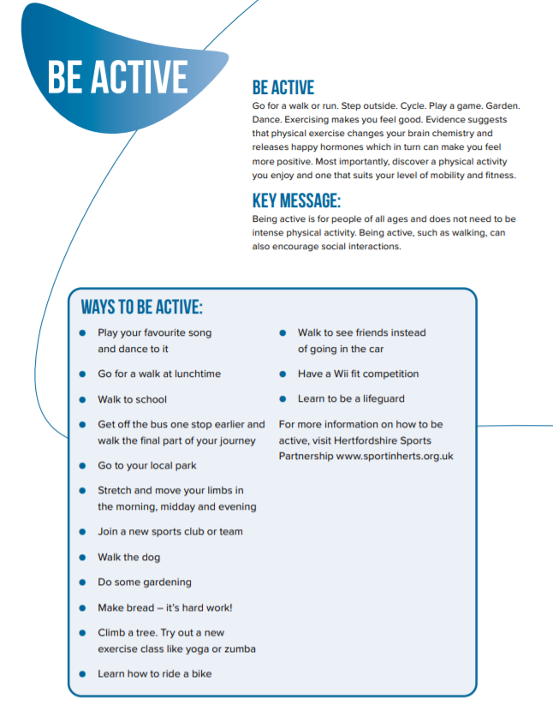

Slide 8
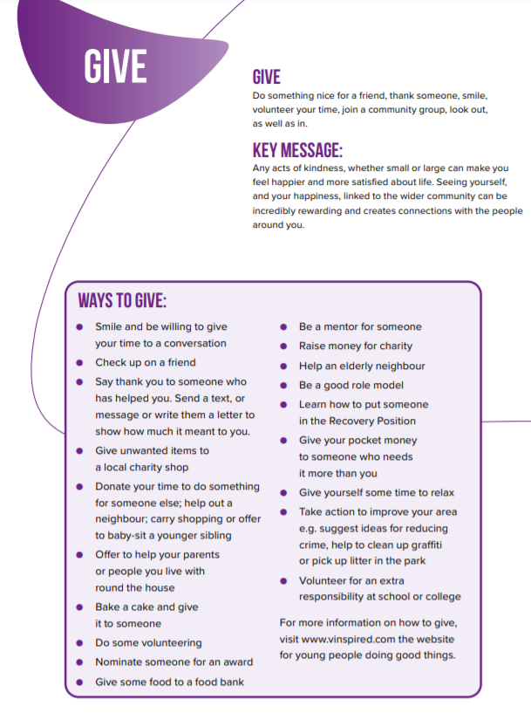

Slide 9


