Slide 1

Briefing for Parents

Slide 2
​LIFE IS 10% WHAT HAPPENS TO US AND
90% HOW WE REACT
-CHARLES SWINDOLL
The ZONES of Regulation is
A FRAMEWORK TO
FOSTER SELF-REGULATION AND
EMOTIONAL CONTROL
​Created by Leah Kuypers, MA Ed., OTR/L

Slide 3
Self - Regulation
Self-regulation is something everyone continually works on whether or not we are aware of it. We all encounter trying circumstances that test our limits from time to time. If we are able to recognize when we are becoming less regulated, we are able to do something about it to manage our feelings and get ourselves to a healthy place. With good role models and support, this comes naturally for some; for others, it is a skill that needs to be taught and practiced.
Self - regulation is the goal of The Zones of Regulation (or Zones for short). ​

Slide 4
Tudor School
Recommended to be helpful for ALL children by Educational Psychologists and County Advisory Teachers
Fits in perfectly with the schools behaviour policy and helps children to use the three steps
Supports children’s mental health as well as their social and emotional development
It can help children to be happier and more successful in their relationships (with peers, adults and teachers), in their learning and work.

Slide 5
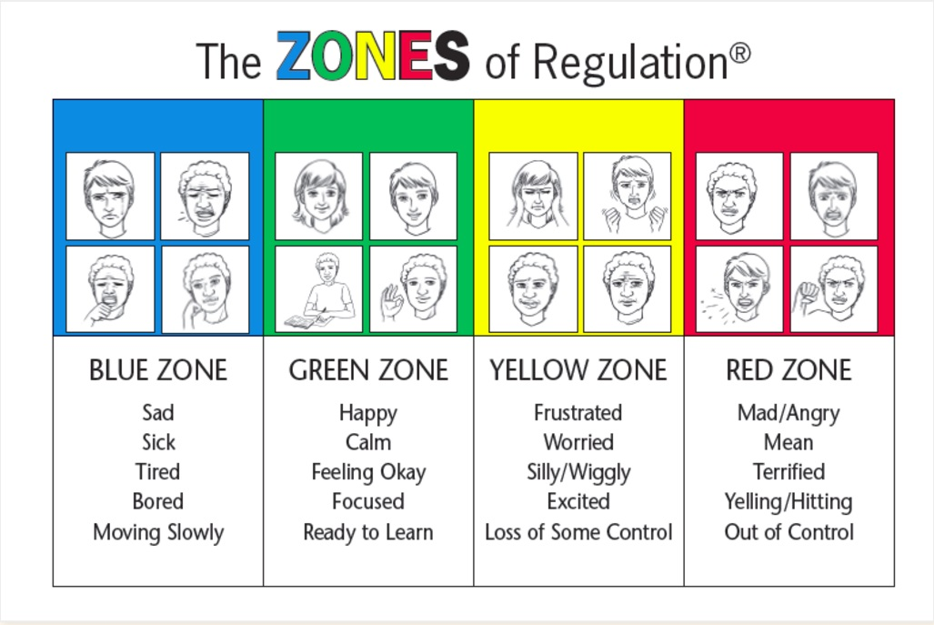
Notes:
THE FOUR ZONES: OUR FEELINGS & STATES DETERMINE OUR ZONE
The Red Zone is used to describe extremely heightened states of alertness and intense emotions. A person may be elated or experiencing anger, rage, explosive behavior, devastation, or terror when in the Red Zone.
The Yellow Zone is also used to describe a heightened state of alertness and elevated emotions, however one has more control when they are in the Yellow Zone. A person may be experiencing stress, frustration, anxiety, excitement, silliness, the wiggles, or nervousness when in the Yellow Zone.
The Green Zone is used to describe a calm state of alertness. A person may be described as happy, focused, content, or ready to learn when in the Green Zone. This is the zone where optimal learning occurs.
The Blue Zone is used to describe low states of alertness and down feelings such as when one feels sad, tired, sick, or bored.
The Zones can be compared to traffic signs. When given a green light or in the Green Zone, one is “good to go”. A yellow sign means be aware or take caution, which applies to the Yellow Zone. A red light or stop sign means stop, and when one is the Red Zone this often is the case. The Blue Zone can be compared to the rest area signs where one goes to rest or re-energize. All of the zones are natural to experience, but the framework focuses on teaching students how to recognize and manage their Zone based on the environment and its demands and the people around them. For example, when playing on the playground or in an active/competitive game, students are often experiencing a heightened internal state such as silliness or excitement and are in the Yellow Zone, but it may not need to be managed. However, if the environment is changed to the library where there are different expectations than the playground, students may still be in the Yellow Zone but have to manage it differently so their behavior meets the expectations of the library setting.
First we teach the language of emotions – helpful because if children can be more specific about what they are feeling we can support them more appropriately. We also teach them how the emotions fit into the different coloured zones. We teach children how to read their emotions and the emotions of others, but knowing what emotions look and feel like.

Slide 6
Emotions and Behaviour
We can’t help how we feel and we are constantly in one or other of the zones. Our zone can change in a split second and we can move between different zones throughout a day and week.
The zones are not good or bad – they are simply a classification of feelings / emotions
Behaviours are described ‘expected’ or ‘unexpected’ – behaviours are not judged, simply described
We are however most successful in our relationships and in our work when we are in the green zone and have the associated expected behaviours of the green zone

Slide 7
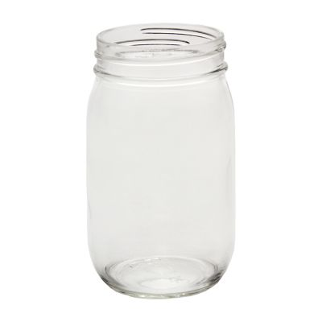
Our behaviour effects what other people feel about us
Expected behaviours lead others to feel comfortable around us
Unexpected behaviours lead to others feeling uncomfortable around us

Slide 8
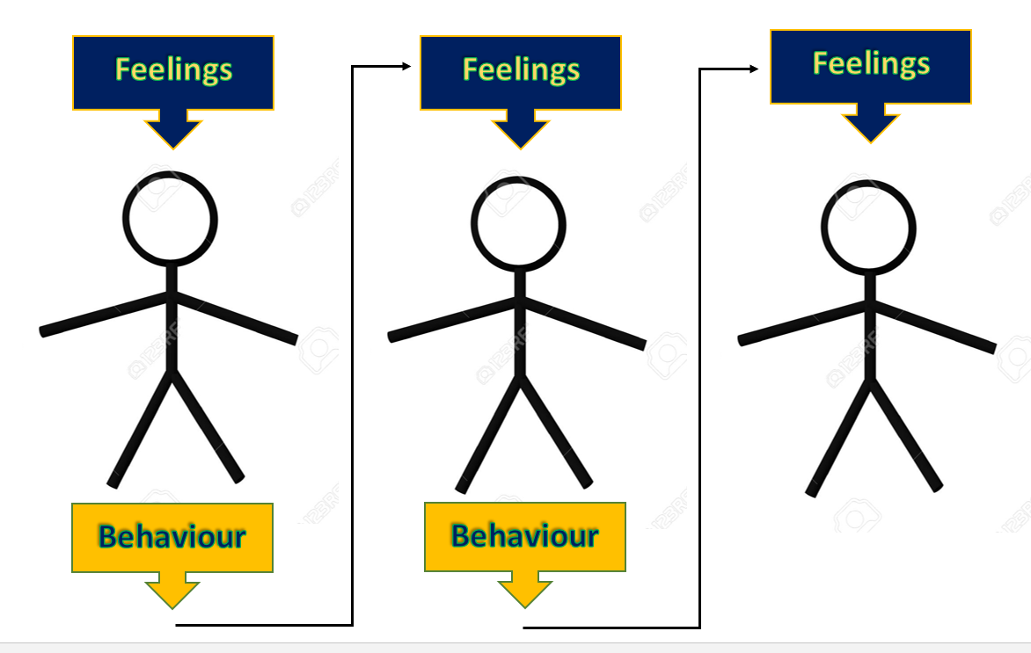
Our behaviours effect how others feel and behave towards us.
Notes:
Ja

Slide 9
The programme also teaches:
Green Zone is most beneficial
What emotions feel like – so we can recognise what zone we are in
What situations / experiences may lead to our zone changing
What people say to describe how they are feeling using idioms: ‘I’m ready to boil’, ‘I’m feeling blue’
During a day your zones may change many times
To think about our triggers for changing zone
What emotions look like – so we can recognise the zones others are in

Slide 10
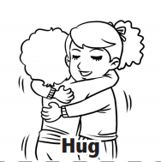
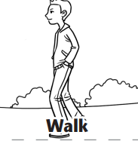
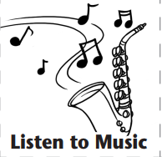
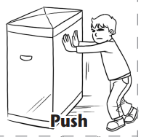
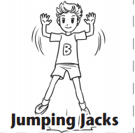
And They’re Off
Exploring Tools to Calm and Alert
Sensory Tools

Slide 11
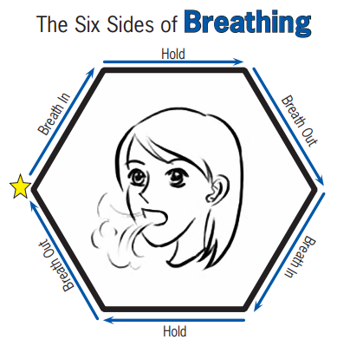
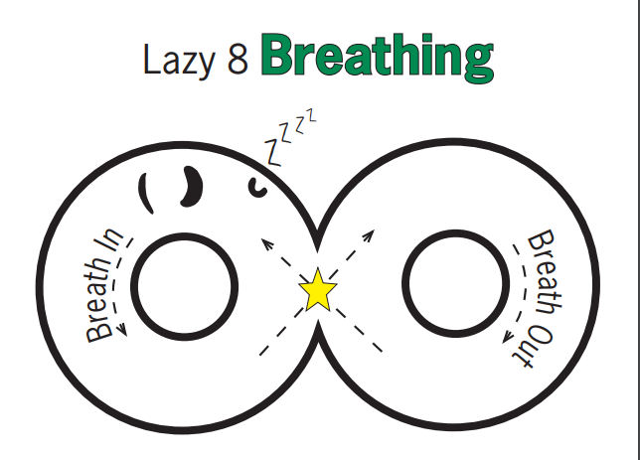
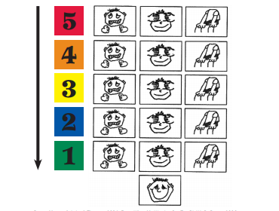
Calming Tools

Slide 12
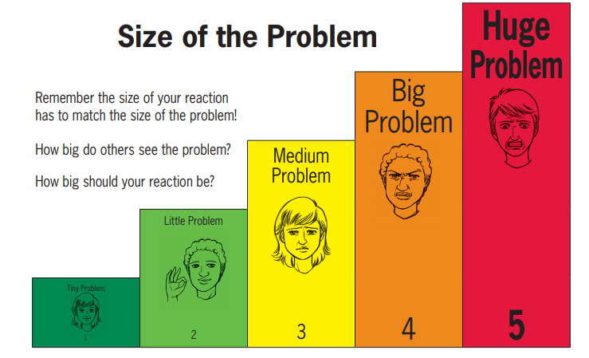
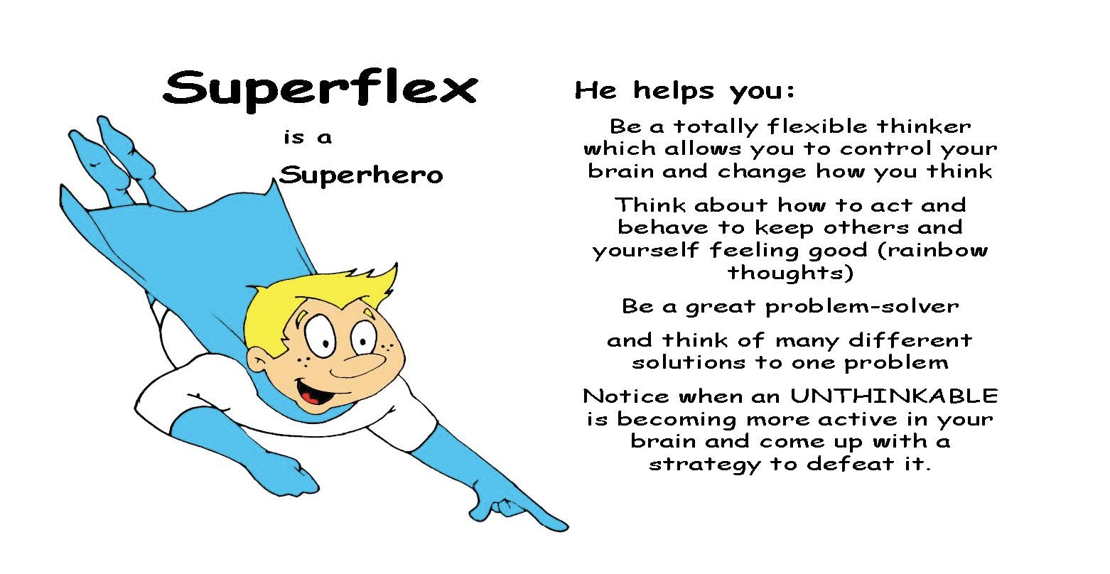
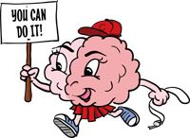
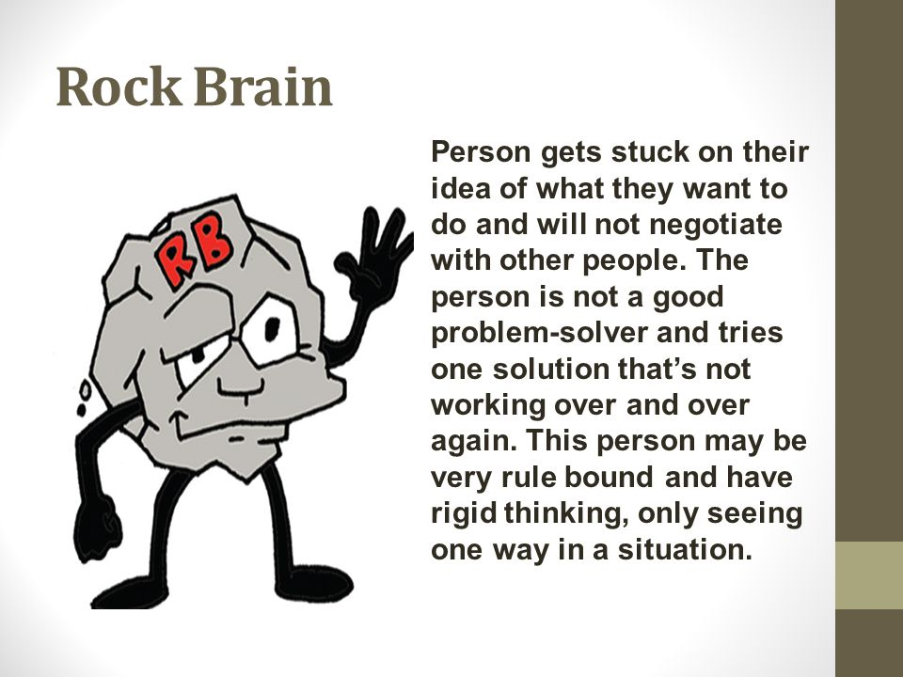
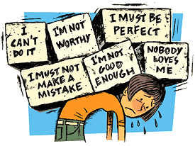
Thinking Strategies

Slide 13
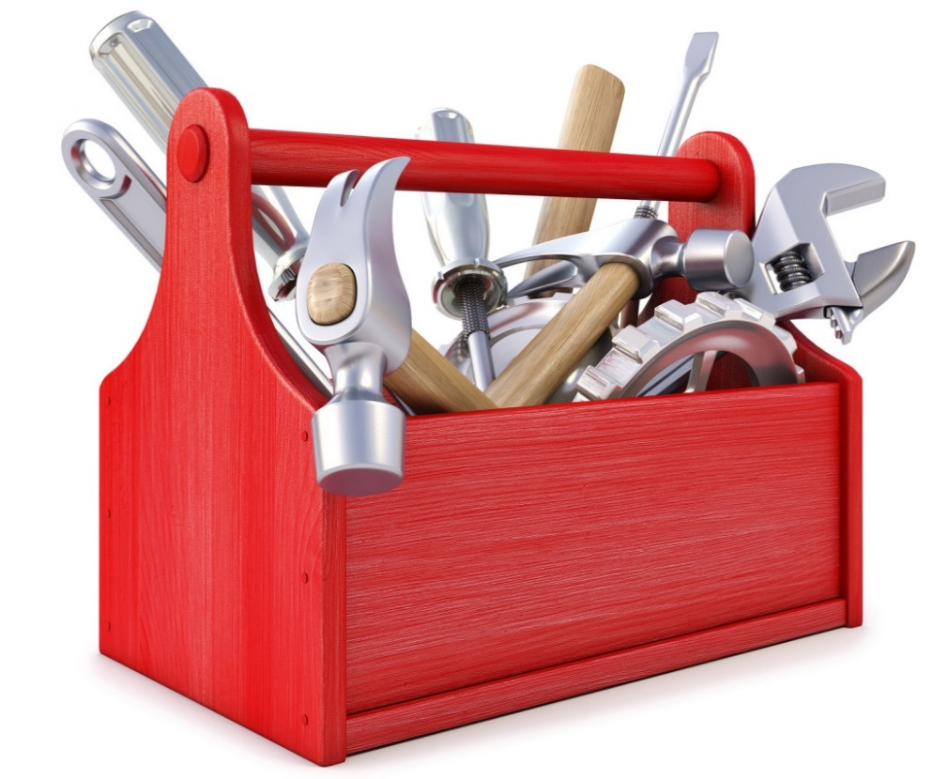
Approaching the Finishing Line
Tools have different purposes and are used for different jobs, knowing which tool to use, and when to use it, takes knowledge and practice
As adults we also need reminders to pick up a tool and use it and we also frequently forget to do this – so children will too.
Teach, remind, support, help, model – be patient!

