Slide 1



Welcome to Tudor Primary School
Supporting Smooth Transitions for you and your child
July 2025

Slide 2

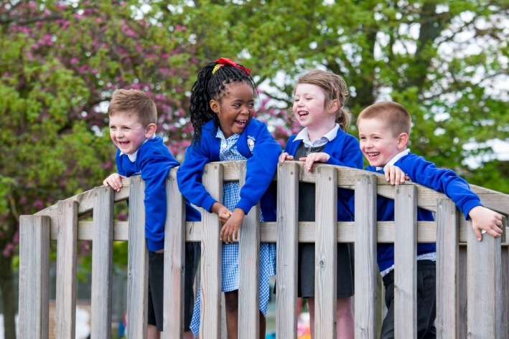
Aims
To give you an overview of
Early Years Foundation Stage (EYFS)
and what your child will be learning
To provide ideas, how we can effectively work
together and how you can best support your child at
home
To help you understand what to
expect from us

Slide 3
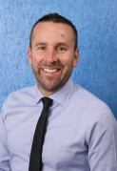
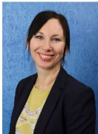
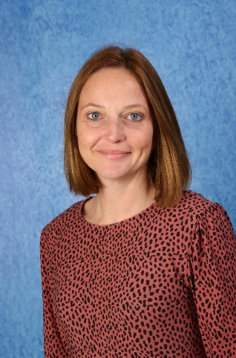
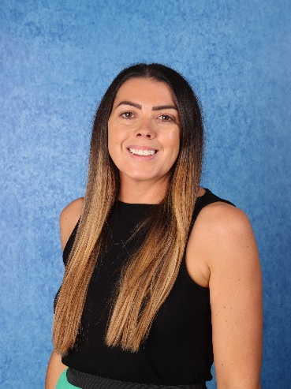
Meet the team
Mr Weightman
Headteacher
Miss Smith
Deputy Headteacher
Miss Reading
Assistant Headteacher / Inco
Mrs Price
Early Years/
Foundation Stage Leader

Slide 4
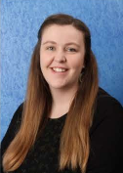
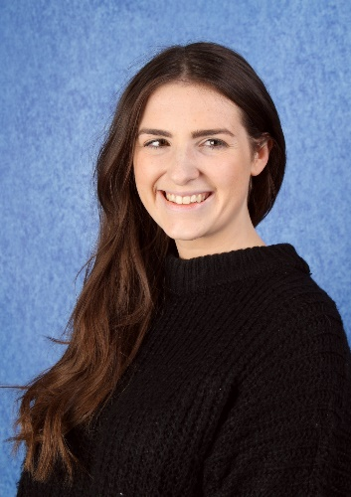
Meet the Teaching Team
Miss Pike
Miss Adams
Mrs Price

Slide 5
Why is transition so important for your child?
Transition: A process not an event – please be honest with us.
Each child is different and some may take a little longer to settle
Our transition processes are based on the best interests and needs of your child
We will work with you to help your child to settle and be confident in their new surroundings
Notes:
Research suggests that children will find it easier to settle into school if they…
have strong social skills
can cope emotionally with being separated from their parents
are relatively independent in their own personal care
have a curiosity about the world and a desire to learn

Slide 6
Getting to know you and your child
We will do this by:
Information gathered from you and the previous setting
Transition for each child carefully planned with you and the class teacher
Opportunities to ask questions and share concerns
Notes:
We always endeavor to liaise with both parents and the children’s previous settings to gather important information to ensure we are ready to support each child’s individual learning needs.

Slide 7
What will my child be learning?
Prime Areas of Learning | Specific Areas of Learning
Personal, Social and Emotional | Literacy
Communication and Language | Mathematics
Physical Development | Understanding the World
 | Expressive Arts and Design
These are the areas of learning which make up the Early Years Curriculum. Education in Early Years is mostly focussed through play, and activities and games are set up for the children to explore to develop these areas of learning.
The adults in the class help facilitate this learning through questioning and building on play and this is tailored to every child’s individual learning journey.
We follow a creative curriculum with a different theme each half term.
Notes:
These are the areas of learning which make up the Early Years Curriculum. Education in Early Years is mostly focussed through play, and activities and games are set up for the children to explore to develop these areas of learning. The adults in the class help facilitate this learning through questioning and building on play and this is tailored to every child’s individual learning journey.
Play and Learn
During play and learn, the children are free to explore the activities set up and resources in the classroom while the adults support their learning through play.
Adult Led Activities
The teacher will also teach the children through short carpet sessions and small group inputs where they will explore a particular subject/topic.

Slide 8
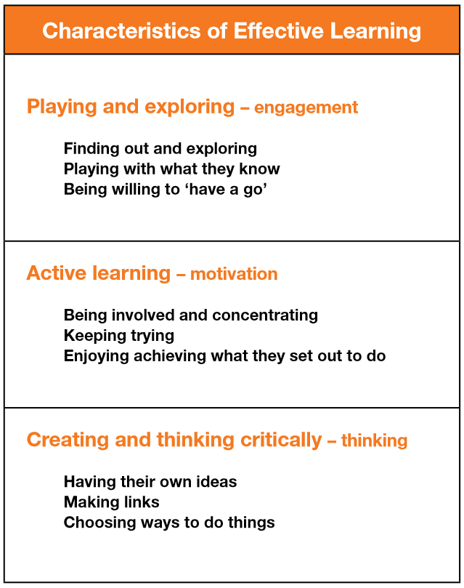
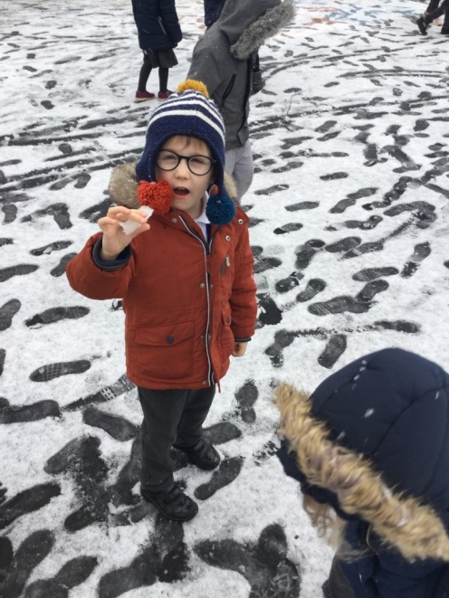
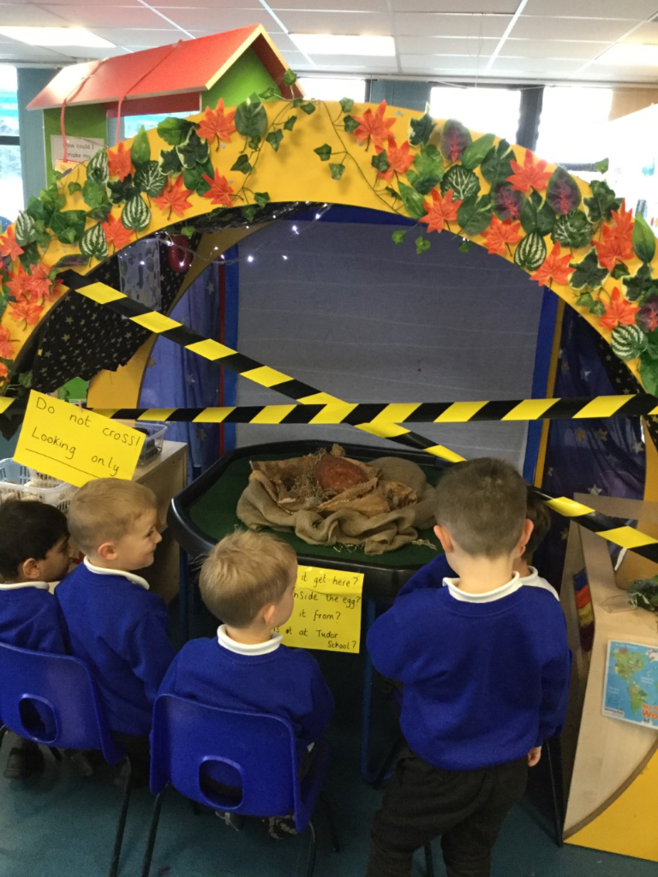
How does my child learn?
Characteristics of Effective Learning
Notes:
Alongside the Areas of Development we look at the ways in which children learn.
The focus of the CoEL is on how children learn rather than what they learn i.e. process over outcome. This allows for teachers/practitioners to provide the right type of learning opportunities.

Slide 9
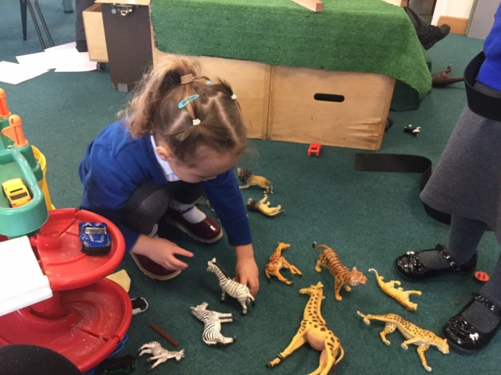
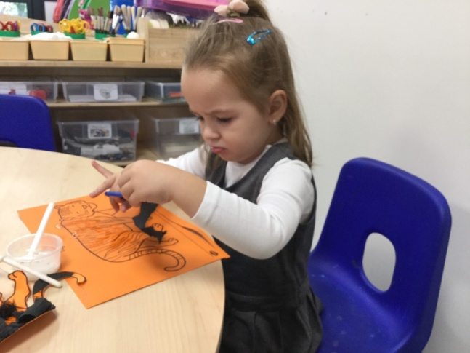
How will my child learn?
Play and Learn
During play and learn, the children are free to explore the activities set up and resources in the classroom while the adults support their learning through play.
Adult Led Activities
The teacher will also teach the children through short carpet sessions and small group inputs where they will explore a particular subject/topic.

Slide 10
Daily routines - NURSERY
8.45am 9.00am 9.20am 11.20am 11.45am | Arrival Welcome activity – children find their morning group and engage in a fine motor activity. Carpet Time Registration, change the calendar and join in our morning wake and shake. There will then be a short focussed carpet input on a particular area of learning. Play and Learn A chance to explore and access resources independently. Teachers will work with small groups of children for Adult Led inputs. SNACK – the children will have snack as a whole class before they access the outdoor area for play and learn. Carpet Time There will then be a short focussed carpet input on a particular area of learning. Home Time

Slide 11
Daily routines - RECEPTION
8.45am 9.00am 9.10am 9.50am 10.45am 11.30am 12.15pm | Arrival Welcome activity – children find their morning group and engage in a fine motor activity. Carpet Time Registration, change the calendar and join in our morning wake and shake. Phonics – whole class Play and Learn A chance to explore and access resources independently, in the indoor and outdoor environments. SNACK – the children will have snack as a whole class before they access the outdoor area for play and learn. Literacy Whole class input leading into focussed group activities. Maths Whole class input leading into focussed group activities. LUNCHTIME

Slide 12
Daily routines - RECEPTION
1.15pm 1.20pm 1.50pm 2.50pm 3.15pm | Register Topic input – whole class Then independent activities in the main area. Play and Learn Indoors and outdoors Tidy up time / story time Home Time

Slide 13
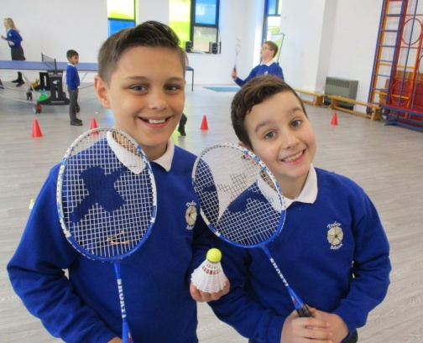
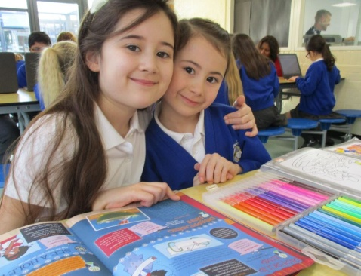
Breakfast Club
We run a breakfast club daily for children of all ages from 7.30am – 8.45am
During the time it is open, children are able to choose a range of tasty foods from the breakfast buffet. There are a number of other activities and these include: art and craft, sports games, computing, learning support, table football, chill out areas and more!
Daily price per child- £5 from 7.30am; £4 from 8am.
Sibling discount - £1 off each
Children in receipt of PPG – 50% off all published prices.
Please speak to our office staff for information about how to book.

Slide 14

After School Club – ‘The Hangout’
Please see the flyer in your packs previously sent to you for more information.

Slide 15
How can I support my child to have a smooth start to school?
I am starting school, ways to help support me to be confident, curious and ready to learn. (this year’s cohort)
Being independent
Feeling school ready
Loving learning
Feeling happy
Trying my best
Notes:
Being independent
I am happy to be away from you as I know you are coming back.
Give me opportunities to meet other children and adults and to spend time away from you.
Help me develop and practice dressing, eating and going to the toilet so that I can care for myself.
Feeling good
I can talk to you about how I feel and any worries I may have.
I know how to keep myself safe and understand there are rules about what I can do.
Make sure I have a healthy diet, lots of opportunities to play outside and be active, and time to sleep at night.
Loving learning
I am interested in finding out about things that interest me.
Provide me with opportunities to be creative; talk to me about my drawings.
Take me to the library and look at books with me; point to pictures and name them clearly, and talk about what we can both see using simple phrases. Tell me stories too.
Talk about what you are doing using a simple commentary; count out the number of apples put in the bag at the shop, and say what we see on the way.
Making my voice heard
I can listen to others; help me practice taking turns and understand sharing.
I can ask for help.
Talk to me using words I can understand, and add words to help extend my vocabulary. This will help me to express what I want, so that others can understand me
Let me sing songs and rhymes.
Provide me with opportunities to meet other children and adults so that I can practice these skills.
Doing my best
I am asking questions about my new school.
Help me be the best I can be and have high hopes for me.
Let me have plenty of opportunities to practice new skills, to make mistakes and try again.
Be positive about going to school; talk to me about school, show me pictures of the school and visit the school. Talk to me about what I am going to do.

Slide 16
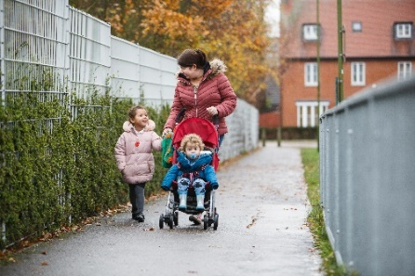
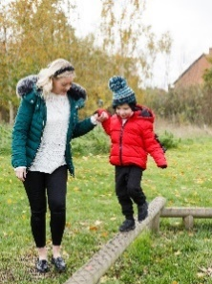
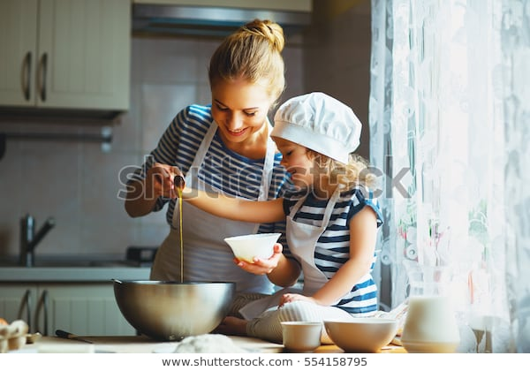
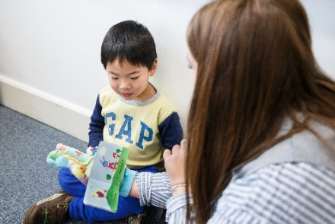
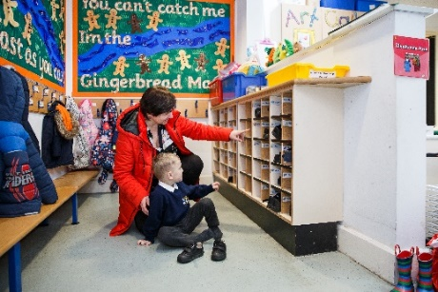
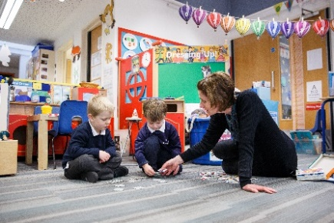
How can I support my child at home?
Communicate and talk with your child
Enjoy physical activities together
Have fun with maths
Help them to be good readers and writers
Support your child to do things by themselves
Encourage your child to talk and play with others

Slide 17

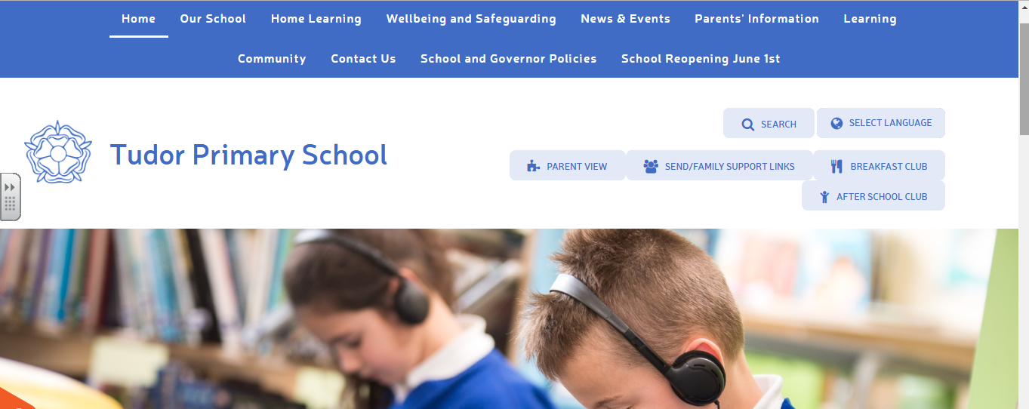
We support learning at home in a variety of different ways
Look out for:
TAPESTRY online learning journal!
Parent consultations meetings
Home learning suggestions
Parent/carer workshops
Information and tips in newsletters, on social media and the school website
Home/school learning packs
Information on displays around school

Slide 18
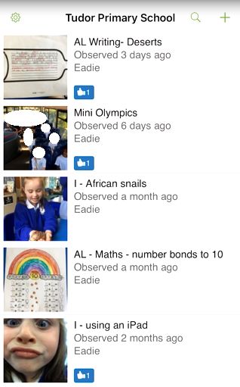
Tapestry Online Learning Journal
Once you have provided your email address, you will be sent an email to set up your own tapestry account. You can access tapestry on most smart devices, tablets and computers.
You will then be able to access your child’s learning observations where you can explore what they have been doing at school.
The observations will be based on a variety of topics and a mix of child initiated activities and adult led inputs.
Tapestry allows you to comment on your child’s observations but also upload your own if you would like to share something your child has learnt at home.

Slide 19
Supporting individual needs
Our SENCo/INCo
Miss Reading
If you are concerned about your child's learning and development discuss this with the class teacher.
The school's Special Educational Needs Coordinator (SENCo) supports children who need additional help.
After consultation with parents/carers, the school/setting can provide a range of additional help for children who need further support with their learning and development, this may include the support of other professionals, individual learning plans and for a small number of children an Education and Health Care Plan (EHCP). Parents are consulted and involved in any discussions and decisions about their child.
For more information about how we support children with additional needs at Tudor, please look at 'The Tudor School Information Report' found in the SEND section of the school website.

Slide 20


Keeping children safe is everyone’s responsibility
Safeguarding/Child protection Children have a right to be cared for and protected and that protecting them is everyone’s responsibility.
It is everyone's duty to respond to concerns about a child's safety. All staff are trained and follow procedures in the schools/settings Child Protection policy (copy on the website).
Mobile Phones Mobile phones must not be used in school/setting. Please see our E-safety policy on our school website to learn about how we keep children safe online.
Road safety and parking – we promote walking to school but if using a car, we encourage you to park in the Tesco’s car park and walk to school from there.
Drop off and collection procedures - a password is required if unknown adults are collecting. Parents should remain on the playground at pick up times and a teacher will send your child down to you.
Accidents - First aid is administered in line with the school/setting policy. Please see school website. Accidents are recorded and risk assessments are undertaken to manage potential hazards.

Slide 21
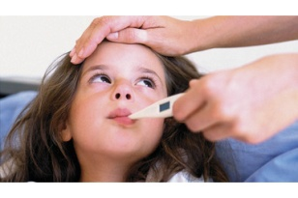


Keeping children safe is everyone’s responsibility
Children who are unwell – School policy is to keep a child off school at least 48 hours after the last attack of vomiting and diarrhea. Please contact the school if your child is unwell.
Birthdays – we request that sweets and treats are not bought in to give out on birthdays due to the risk to those with allergies.
Attendance - 97% attendance expected. It helps children to have a good routine and children who attend regularly, settle more easily and make better progress with learning and development.

Slide 22
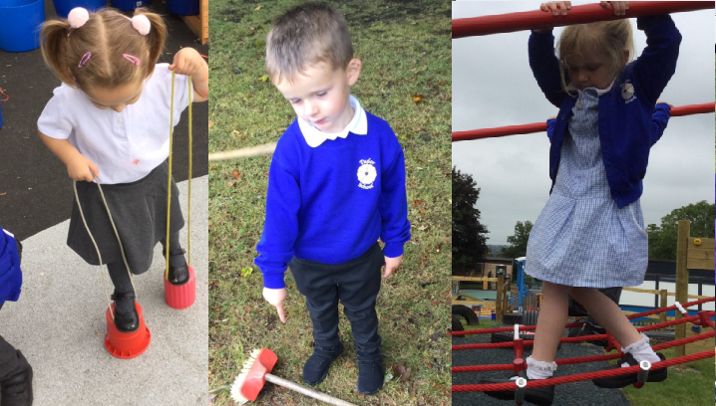
Uniform
White Polo Top
Tudor School Jumper or Cardigan
Grey Tights/ Trousers/ Shorts
Grey Dress/ Blue and white Summer Dress
Black Shoes
PE Kit and uniform is available to purchase at our school office. Please contact our office team for more information.

Slide 23
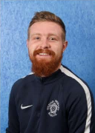
PE - Reception
On Friday’s, all children in reception will have the opportunity to take part in a PE lesson with our Sports Coach, Mr Higgins.
On Fridays, children should come to school dressed in their PE Kit, not their usual school uniform.
This should consist of a Tudor School white PE top, blue shorts/trousers, a school jumper, and appropriate footwear for outdoor PE.
PE kit is available to purchase from our school office, please contact our admin team for further information.

Slide 24
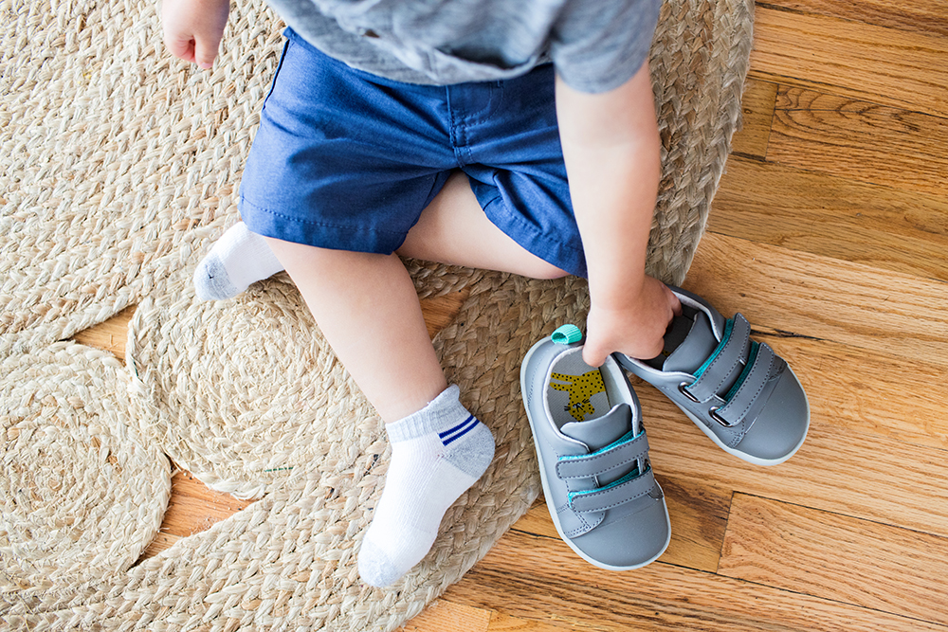
PE - Nursery
On Monday’s, the children in Nursery will take part in a PE lesson in the hall.
They do not need PE kit.
Nursery class will practise the skill of taking off/on their shoes and socks before the go into/return from PE.

Slide 25
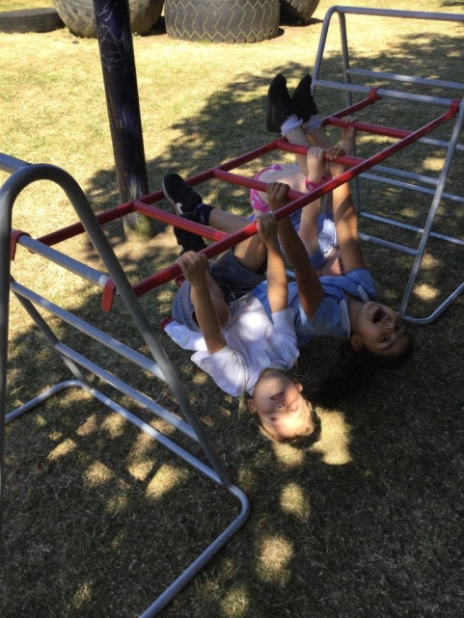

What your child will need at school...
Suitable clothing e.g. Coat, sun hat
A Book bag – This should have your child’s reading record and their home school diary in it.
Change of clothes in case of accidents, including underwear – in a plastic r draw-string bag kept on their peg. PLEASE DO NOT PUT THIS IN A RUCKSACK.
A named water bottle.
Please make sure all items of clothing are named e.g. Coats and jumpers.
For reception children, a healthy lunch in a named lunchbox if your child is not having school dinners. (Please note that no nuts or products containing nuts should be sent into school.)
It is recommended that your child has a puddle suit in school at all times to explore the outdoor area comfortably.

Slide 26


How we communicate with you
Communication is so important. It plays a huge role in ensuring that you are regularly sharing information with us to best support your child.
We do this by…
Children’s red ‘Home/School Diary’ – please use this diary to give your child’s teacher a message/ask a question and they will get back to you ASAP. Please ensure it is handed to the adult on the door in the morning if it contains a message, and check it daily for messages from the teachers.
Termly parent consultation meetings
Newsletters
Social Media –Twitter @TudorPrimaryHH
School Website - https://www.tudor.herts.sch.uk/
Friends of Tudor, our school PTA Facebook page - https://www.facebook.com/FriendsofTudor

Slide 27

We look forward to welcoming you and your child to Tudor Primary School
Notes:
Insert the name of your school/setting.
Photos of your own school/setting can be inserted

